Slide 1
DeVry University
College of Engineering and Information Sciences
Python Stock Tracking Project
By;- Temesgen Kune
Bachelor, DeVry University
Professor: Ahmed Azam
CEIS150: Programming with Objects
Jun28, 2023

Slide 2
Introduction
Creating applications in Python by using object-oriented techniques to develop a stock tracking application.
The application will have both console and GUI (Graphical User Interfaces).
By processing the historical stock data, profit/loss reports can be generated.
The system will use the Python libraries to create charts and get historical stock data from web sites.

Slide 3
Objectives – Module 1
1. Install Anaconda (if necessary)
2. Chose an IDE for your Project
3. Create a python program

Slide 4
Program
Screen shot of Python program running successfully.

Slide 5
Objectives – Module 2
1. Create Class Diagrams
2. Create Classes
3. Run Unit Test

Slide 6
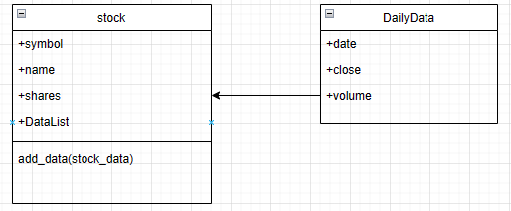
Class Diagram
Paste your Visio Class Diagram

Slide 7
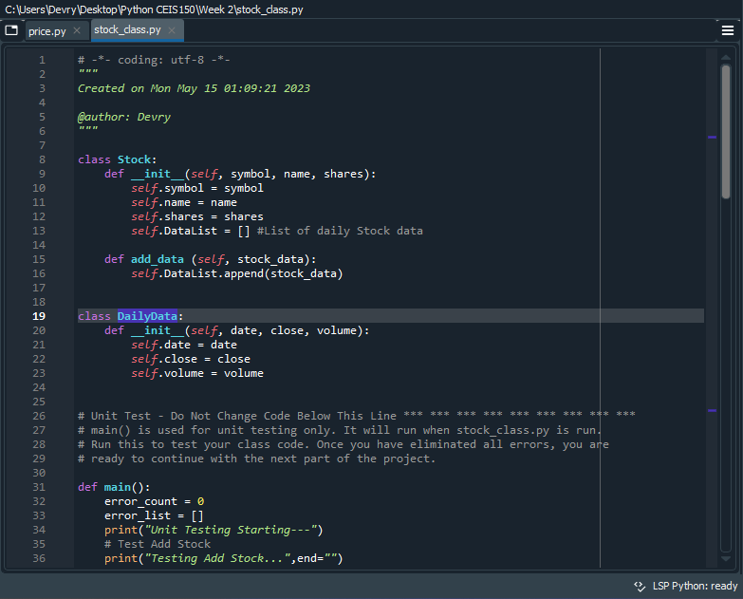
Class Code
Screen Shot of your stock_class.py file.

Slide 8
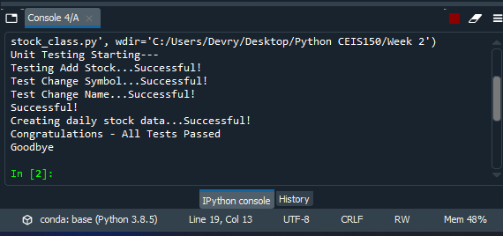
Unit Test
Screen Shot of your successful
unit test.

Slide 9
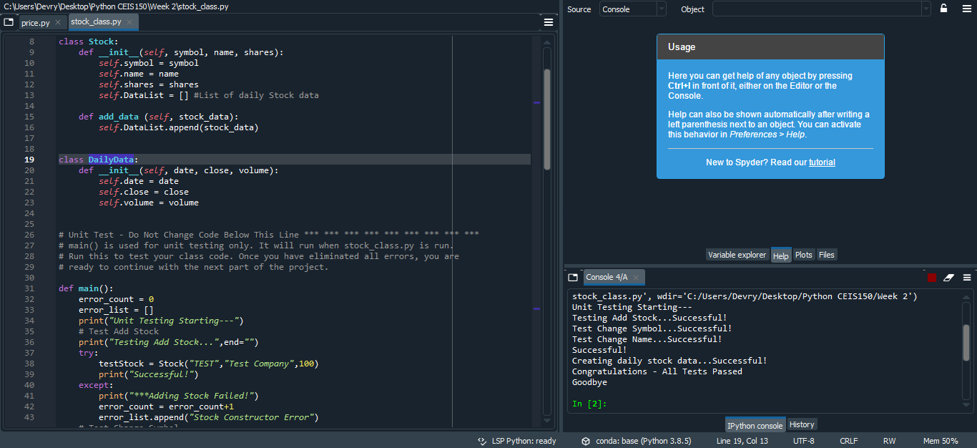
Unit Test
File and success

Slide 10
Objectives – Module 3
Create a Menu-Driven User Interface to Add/List/Delete Stocks and to Track Price and Volume History
Create Functions to handle menu items

Slide 11
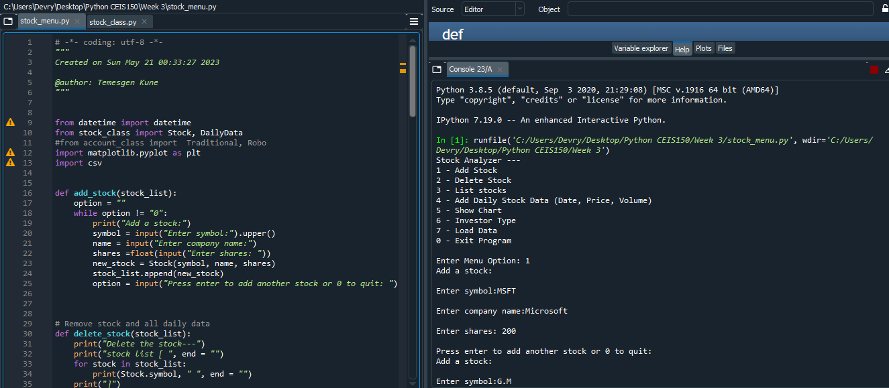
Adding a Stock
Paste a screen shot of your working Stock program.

Slide 12
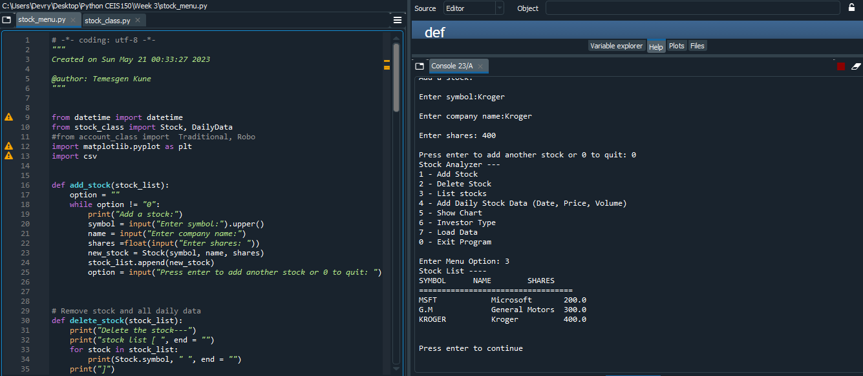
Listing 3 Stocks
Paste a screen shot of your working Stock program.

Slide 13
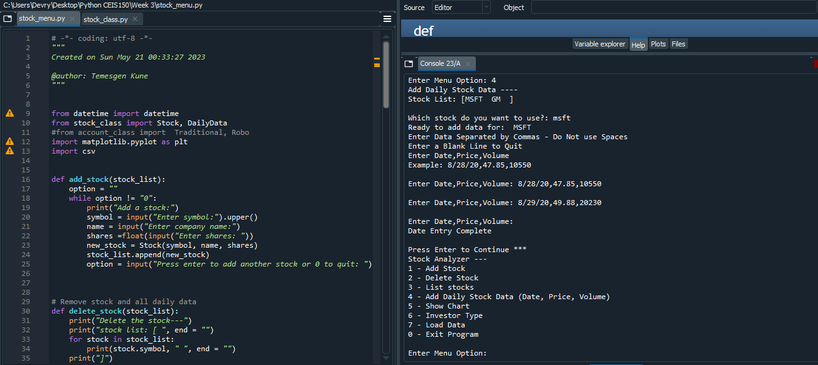
Daily Data
Paste a screen shot of your working Stock program.

Slide 14
Objectives – Module 4
Implement inheritance in the stock program
Create three classes
Run Unit Test

Slide 15
Inherited classes
Paste a screen shot of your classes

Slide 16
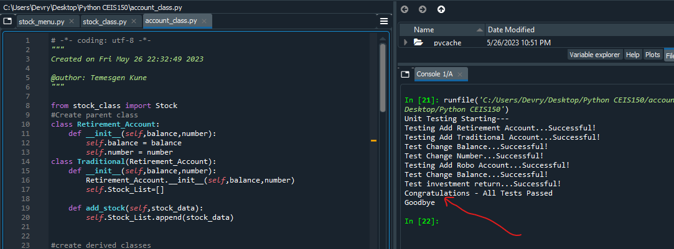
Unit Tests
Paste a screen shot of your unit tests successfully completed

Slide 17
Stock menu program
Paste a screen shot of your classes in the main program
Traditional Type

Slide 18
Stock menu program
Paste a screen shot of your classes in the main program
Robo type

Slide 19
Stock menu program
Paste a screen shot of your classes in the main program
Robo type

Slide 20
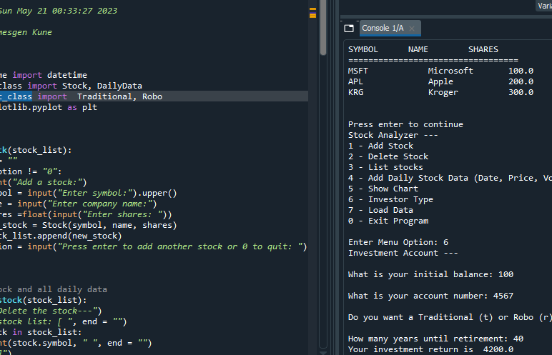
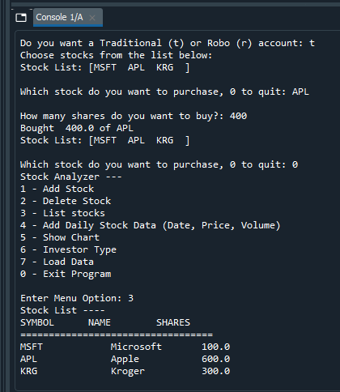
Additional Slides (After Traditional shares)

Slide 21
Objectives – Module 5
Use the pyplot class in the matplotlib library to create a simple stock chart.

Slide 22
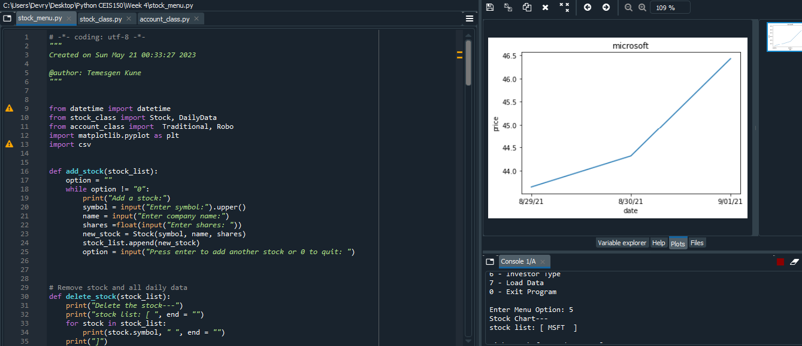
Chart
Paste a screen shot of your stock chart.

Slide 23
Objectives – Module 6
Use the csv library to import data from Yahoo! Finance.
Read data from a file

Slide 24
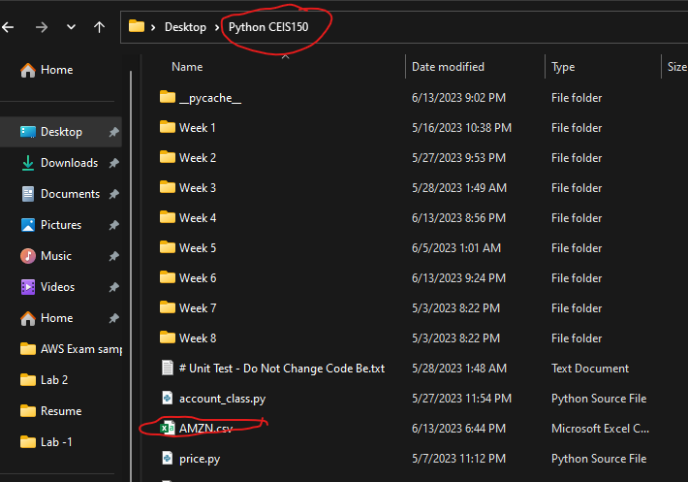
File
Paste a screen shot of the file downloaded from Yahoo finance

Slide 25
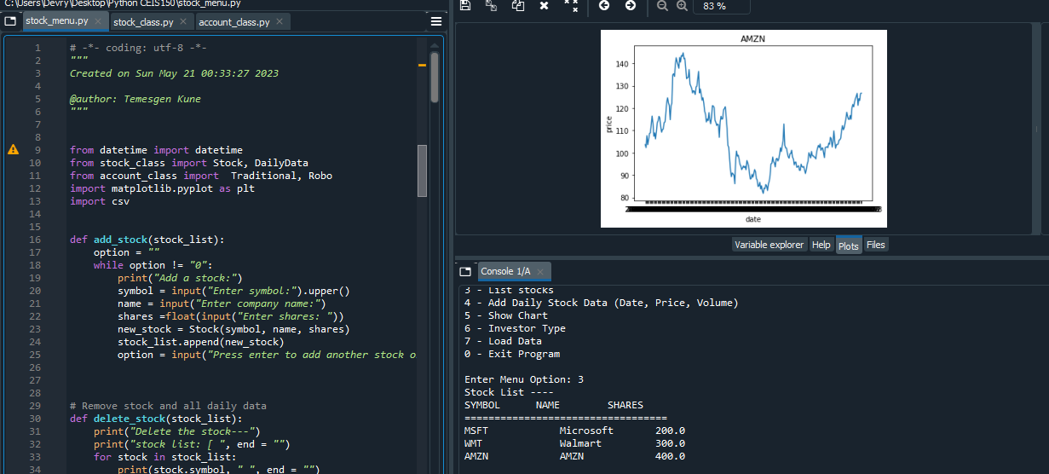
Stock Lists
Screenshot of the historical data import

Slide 26
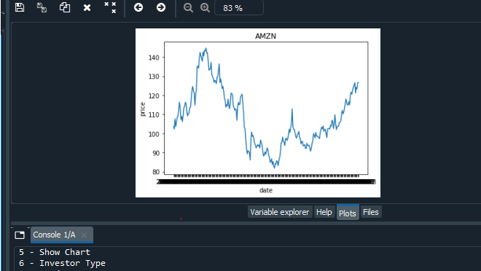
Importing data (CSV file)

Slide 27
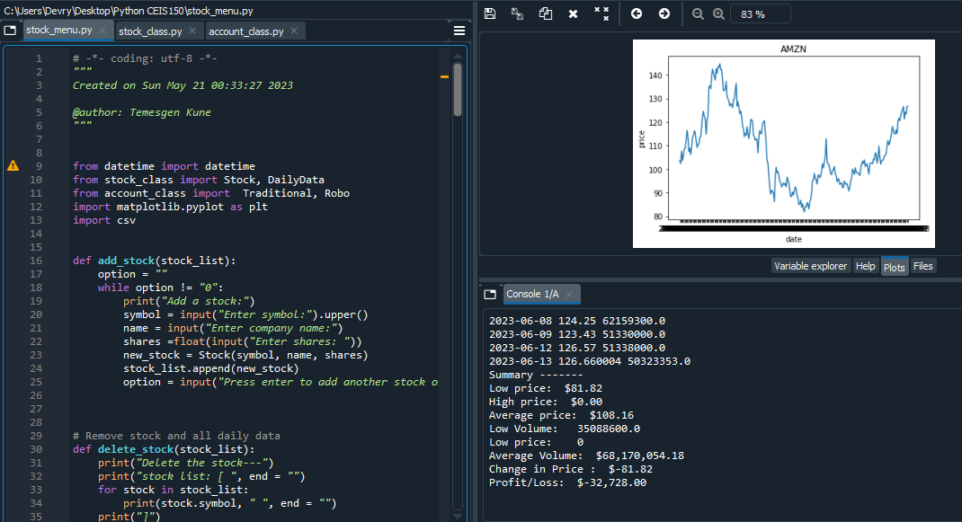
Statistical Data

Slide 28
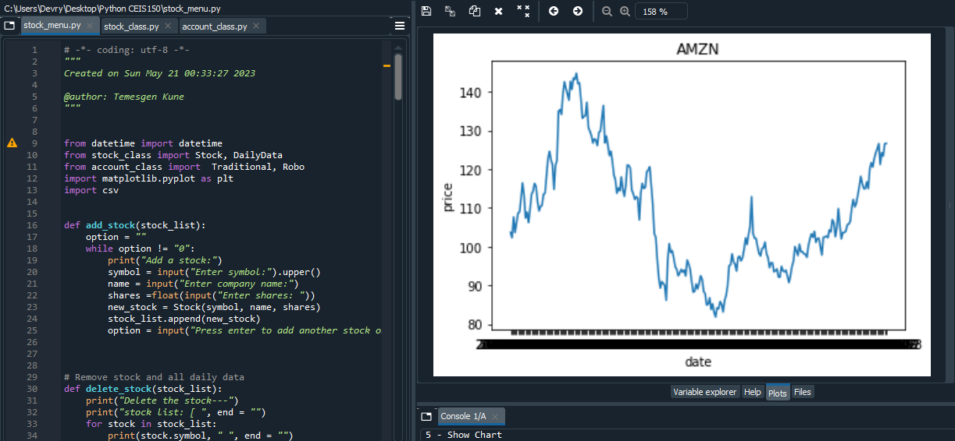
Chart

Slide 29
Objectives – Module 7
Use tkinter to implement a graphical user interface.

Slide 30
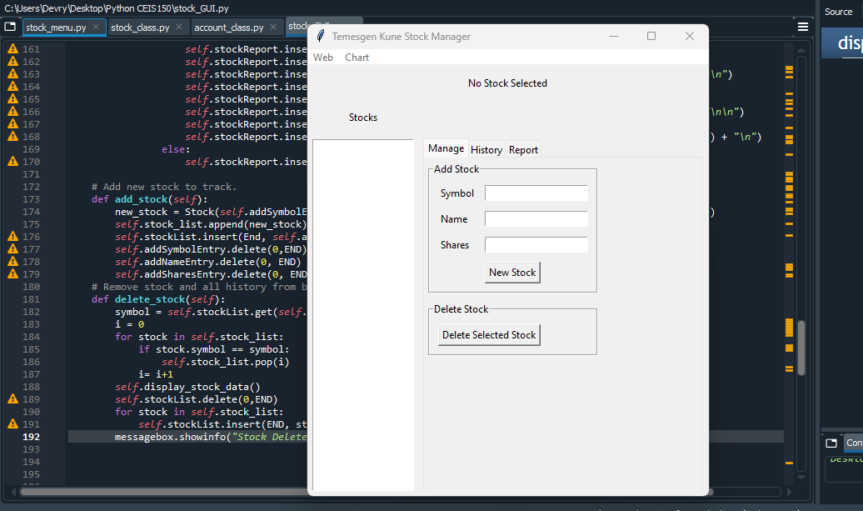
Stocks in GUI
Paste a screen shot of your GUI working

Slide 31
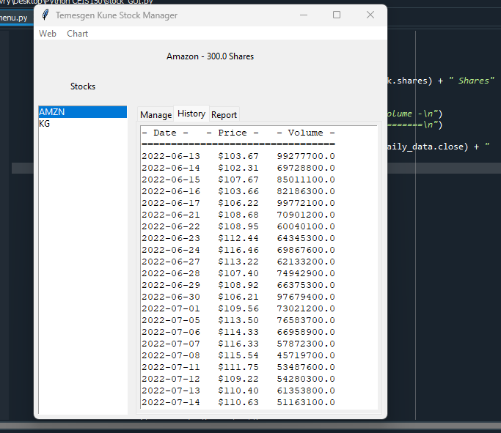
History Tab
Paste a screen shot of your History tab with import working.

Slide 32
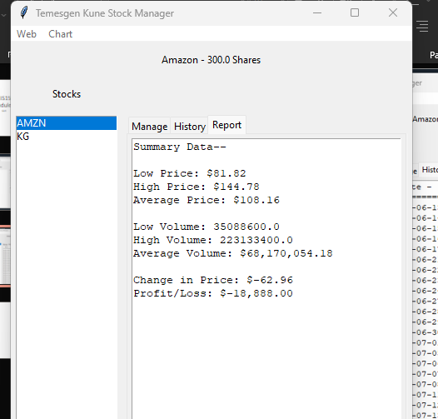
Report Complete
Paste a screen shot of your Report tab

Slide 33
Career Skills Developed Conclusion
Creating classes that represent real-world entities or concepts.
Encapsulation by bundling data and related methods within a class.
Writing more flexible and extensible code by leveraging dynamic binding and method overriding.
Analyzing data

Slide 34
Conclusion
Object
Object Oriented programing is recommended course for new coders and IT experts.
Object
oriented programing is real world problem solver that Every IT personnel
Become
one of the most popular programming languages in the world

