Slide 1
Final course project
NETW 320 - Converged Networks with Lab
Professor Khaled Elbehiery
Dec, 2022 By: Temesgen Kune

Slide 2
Introduction
New technologies and applications are being developed on a regular basis.
It is important to stay current with the skills required for evolving
job market and to take advantage of the many available learning opportunities.
This course examines foundations for current and emerging networks that
deliver voice, data and video/imaging through various technologies.
This project covers;
Core switching,
Broadband and edge access,
Internet protocol telephony,
Adding packet capabilities to circuit-switched networks,
Current generation of wireless mobile telecommunications technology,
Presence- enabled communications, security and troubleshooting.

Slide 3
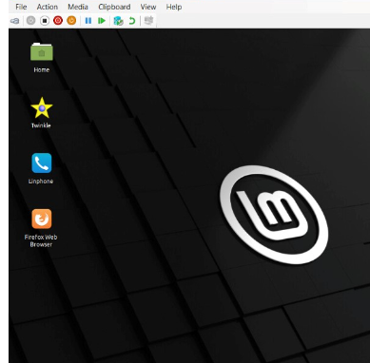
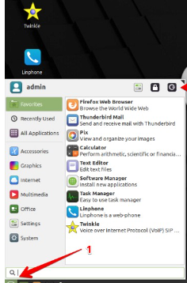
Module-1 Project Preparation
Navigate the Microsoft Hyper-V environment.
Access virtual machines that are used for the course project.

Slide 4
Module-2
Audio and Video Codecs
Audio and video codecs play an important role in transmitting multimedia content over an IP network.
In this module you will set up a call between two SIP clients and observe the audio and video codecs used by the SIP clients.

Slide 5
Create SIP Accounts
The screenshot should show the All Extension tab of the Asterisk Server A, with both extensions (6001 and 6002) being displayed.

Slide 6
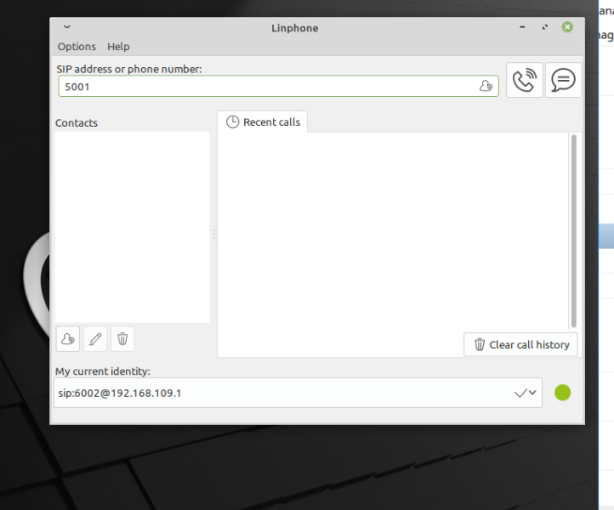
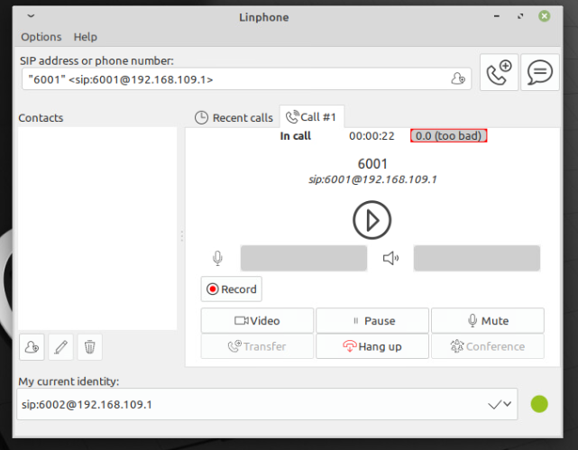
Register SIP Clients
This screenshot should show the Lin phone window, with sip:6002@192.168.109.1 being displayed in the My current identity field.
This screenshot should show the Lin phone window with the in call status and timer xx:xx:xx information.

Slide 7
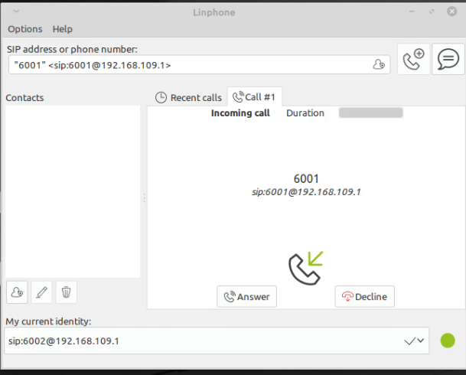
Additional Slides- incoming and missed calls

Slide 8
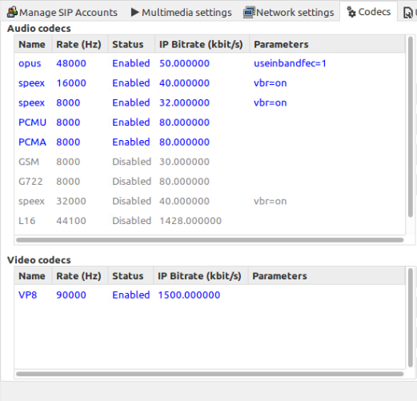
Audio and Video Codecs
The screenshot should show the Settings window of the Lin phone, showing the audio codecs and video codecs.
Among the audio codecs enabled for the Lin phone, which one requires the most bandwidth per call? Which one requires the least bandwidth per call?
Answer: opus requires the most bandwidth.
Which video codec does the Lin phone use? How much bandwidth would such a video session consume?
Answer: -VP8.
-Vp8 consumes at least 90000 Hz per session.

Slide 9
Module-3 Real-Time Protocol (RTP)
Real time protocol (RTP) was developed to support audio- and videoconferencing.
It provides key capabilities to support real-time data transport, such as timestamps, sequence numbers, payload source and identification, reception quality feedback, and media synchronization.
Although RTP does not specify a transport protocol, IP/UDP is almost always used to deliver RTP packets.
In this module you will use Wireshark, a packet analyzer, to view the RTP packets that are exchanged between two SIP clients.

Slide 10
Additional Information
What’s the value of the Timestamp field? Time stamps are: 1913068359 and 1913068199.
Subtract the timestamp value from Step 9 from the timestamp value here to determine the unit of time contained in each packet.
1913068359-1913068199=160/one unit which is 1/8000 sec.

Slide 11
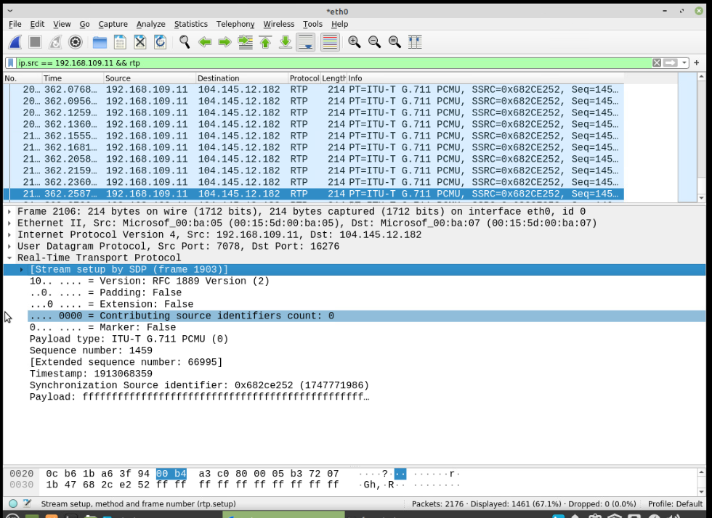
RTP Packet Payload Size
These screenshots should show the Tree View section of two consecutive RTP packets (the difference between their sequence numbers is 1), respectively. Make sure to capture the payload type, sequence number, and timestamp information.

Slide 12
RTP Packet Payload Size
1. If each increment of the RTP timestamp clock (i.e., one unit) represents 1/8,000 of a second, how many seconds or milliseconds of conversation are carried in each RTP packet? 160*$\frac{1}{8000}sec=$0.02millisecond
2. Given the G. 711 codec bit rate as 64,000 bits per second, the payload size in seconds or milliseconds calculated above can also be represented in $(64,000∗0.02 )$bits or 160 bytes.
3. Subtract from the Total length above: 20 bytes for IP header, 8 bits the or UDP header, and 12 bytes or RTP header.
Payload length (in bytes) = Total length – 20 – 8 – 12 = 200-20-8-12 which is 160.
4. Does the payload length in bytes match the payload size in bytes in Step 11?
Answer: Yes, payload length and Payload size are equal.

Slide 13
Module-4 Session Initiation Protocol (SIP)
Session initiation protocol (SIP) is a voice-over-IP (VoIP) standard.
It’s also used to initiate videoconferencing sessions. SIP can build conferences for all types of multimedia.
Wireshark is used to capture and view the SIP messages that are exchanged between two SIP clients.

Slide 14
SIP Messages
The INVITE – 200 OK – ACK message sequence you observed in Steps 2, 5, and 6 is the three-way handshake used to establish an SIP session. The following values are used to uniquely identify this call:
Tag value (the value that follows the From: field) from Step 2: v73dMLL9_
Tag value (the value that follows the To: field) from Step 4: e34e9888-ec13-4b5d-80bc-8a25ef8b88dd
Call-ID value from steps 2, 3, 4, 5, and 6: UcmfE1FH
Do the tag values and Call-ID value in the BYE – 200 OK – ACK sequence match?
Answer: Yes, they have the same value.

Slide 15
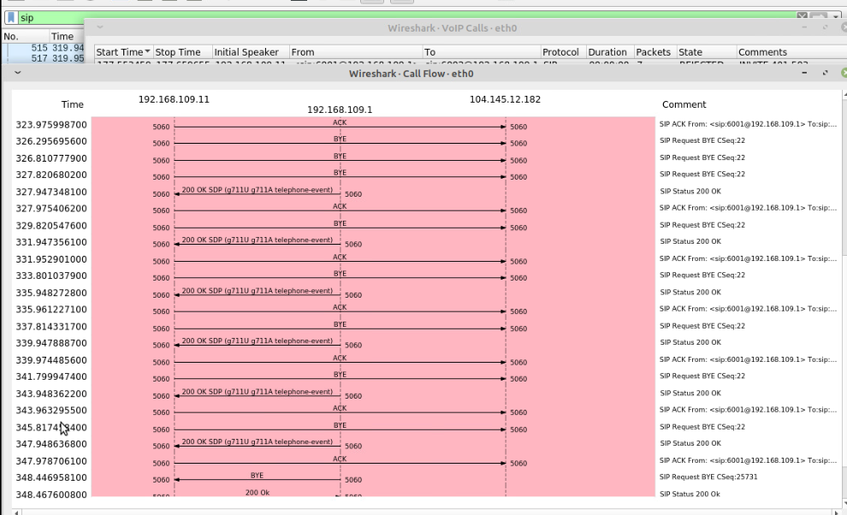
Protocol Sequence Diagram
The protocol sequence diagram should show a summary of messages exchanged among the SIP clients and SIP server during the SIP session setup and tear-down process.
SCREENSHOT HERE

Slide 16
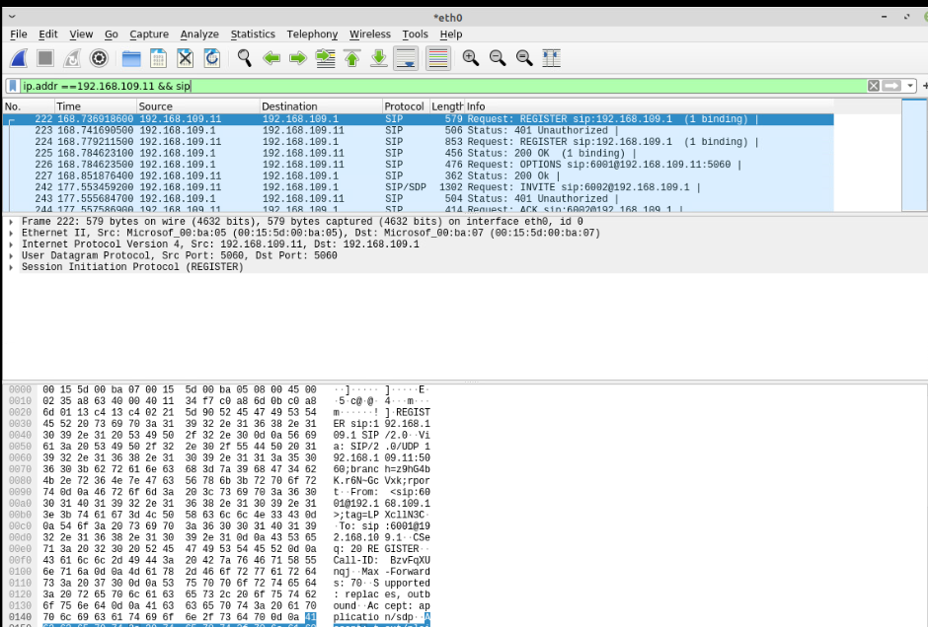
Filter SIP

Slide 17
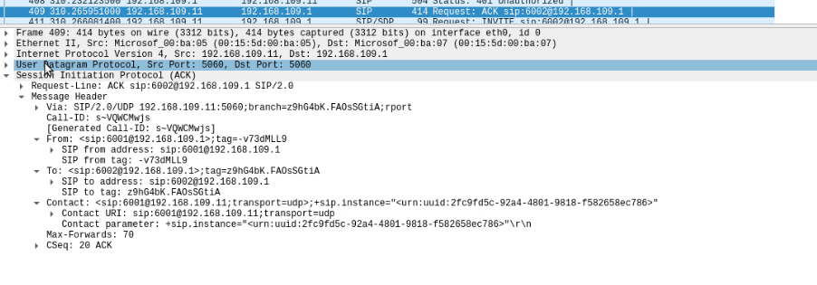
ACK

Slide 18
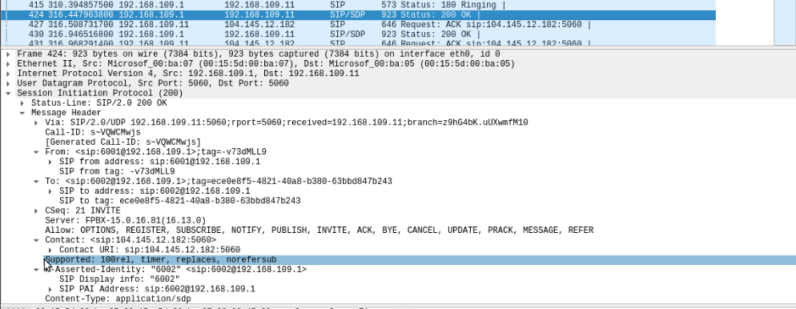
200 ok

Slide 19
BYE

Slide 20
NETW320 Course Project Module-5 RTP Security

Slide 21
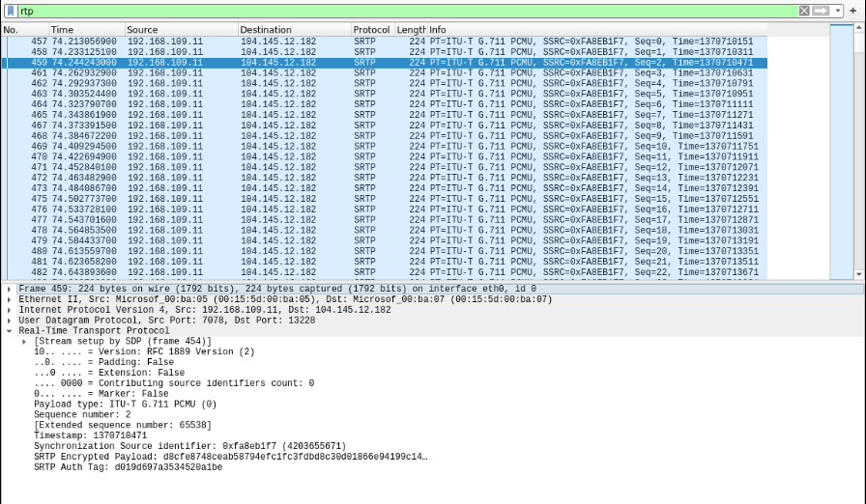
Secure Real-time Transport Protocol (SRTP)
This screenshot should show the Wireshark Packet View window, with the encrypted RTP or SRTP packets.

Slide 22
Secure Real-time Transport Protocol (SRTP)
This screenshot should show the Wireshark Tree View window, with the encrypted payload of a SRTP packet.

Slide 23
Module-6 SIP Security

Slide 24
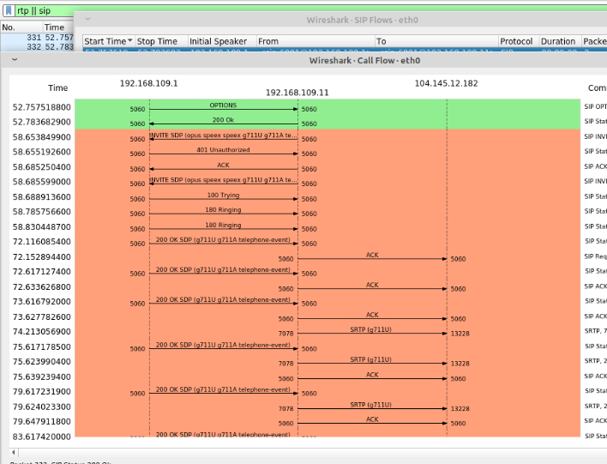
RTP Stream Decryption
This screenshot should show the protocol sequence diagram of SIP flows.
SCREENSHOT HERE

Slide 25
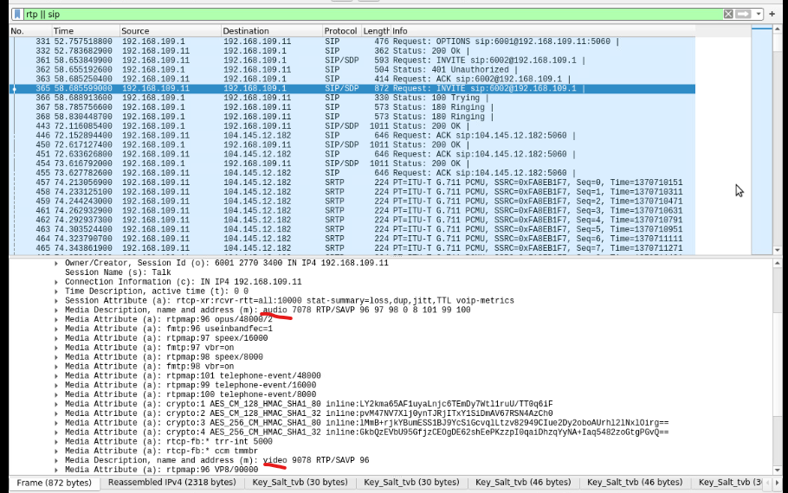
RTP Stream Decryption
This screenshot should include the Wireshark Tree View section, showing the two groups/sets of crypto: entries.
SCREENSHOT HERE

Slide 26
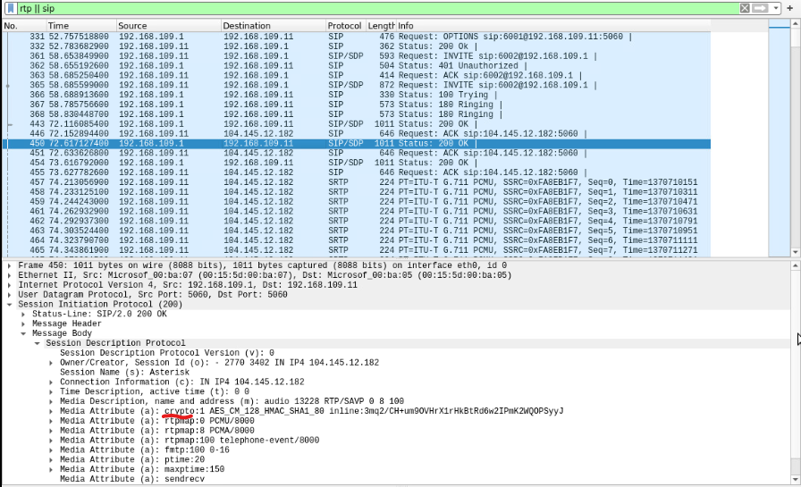
RTP Stream Decryption
This screenshot should include the Wireshark Tree View section, showing the single crypto: entry used to encrypt messages from Asterisk Server to SIP Client 1.
In the crypto: entry name, AES_CM_128_HMAC_SHA1_80, what encryption algorithm, authentication method, and hashing algorithm could you identify?
Answer: 128-bit secure hash algorithm with Advanced Encryption Standard (AES) which is communication and Media encryption Method.

Slide 27
Challenges
Virtual machine connection congestion.
Typing errors while in VM terminals.
Unexpected outputs from the commands.
Data inconsistency.

Slide 28
Career skills obtained
Working on Virtual Machine.
Data analysis.
Media communication codecs
Troubleshooting errors in coding
Communication tracking

Slide 29
Conclusion
It is an amazing hands-on experience working on virtual environment.
Applications and process tracking experiences are helpful in future career.
The project is hands on training for beginner media communication and network security.

