Slide 1
CEIS110
Programing With data
Temesgen Kune

Slide 2
INTRODUCTION
Develop a software system to download weather data from a cloud source,
      store it in a database,
      extract desired subsets for processing.
Use programming and data analytics to analyze data and develop charts and predictions.
Data analysis using Python program Step by Step.

Slide 3
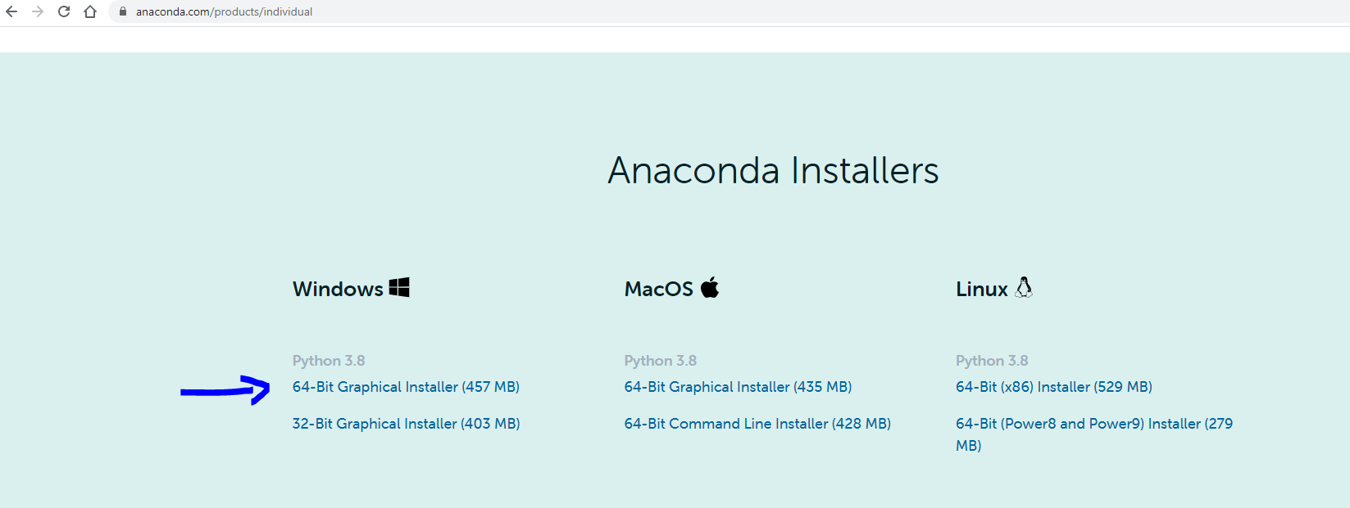
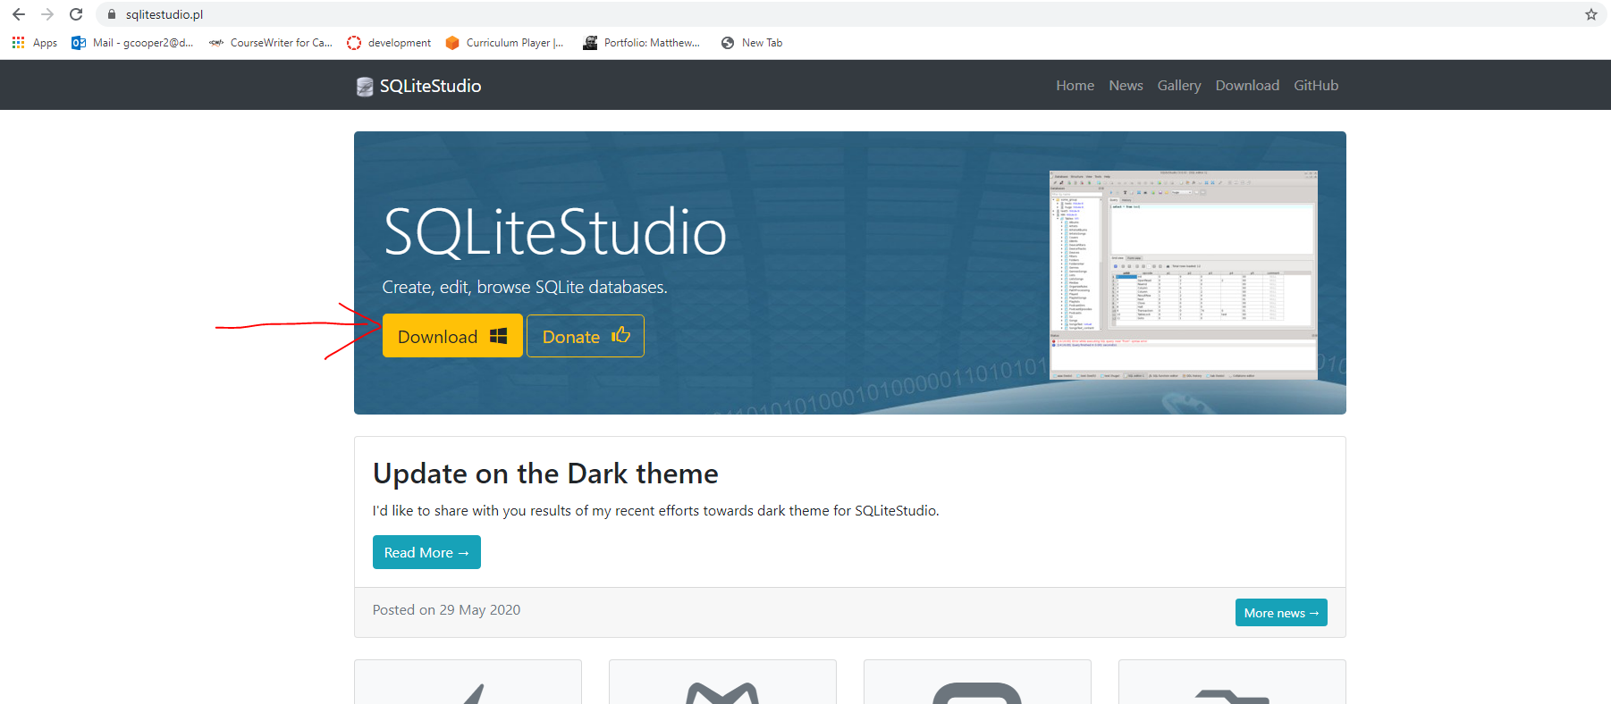
Step 1
          software setup
          software development process.
          Excel, SQLite Studio, Anaconda.

Slide 4
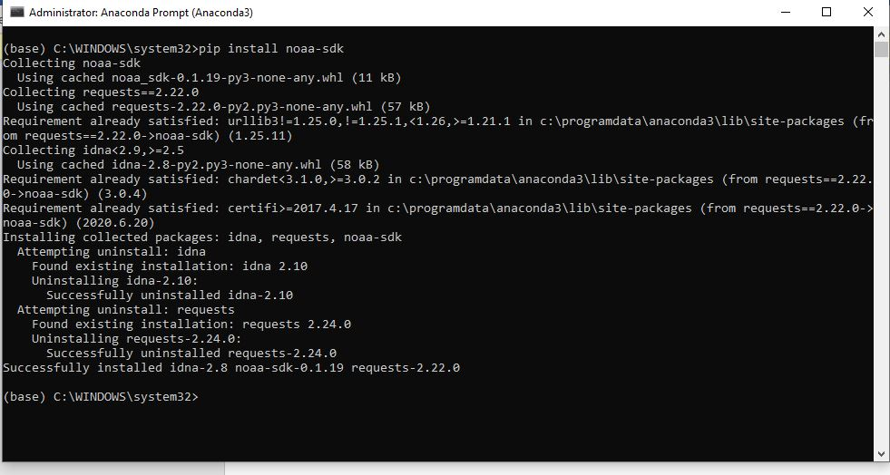
Software Inventory
(Screenshots)
Include screenshot of NOAA-SDK library installed
Ensure result "Successfully installed noaa-sdk" of pip install command is visible in your screenshot.

Slide 5

Step 2
Downloading weather data
Objectives
To use a flowchart as a design tool
To develop a flowchart for the course project
To generate a prototype design of a software system
To install necessary python libraries

Slide 6
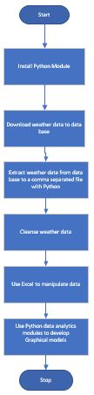
Flowchart
Include the following processes:
Install python
Download weather data to a database.
Extract weather data from database into a comma separated file with python
Cleanse weather data
Use Excel to manipulate data
Use python data analytics modules to develop graphical models

Slide 7
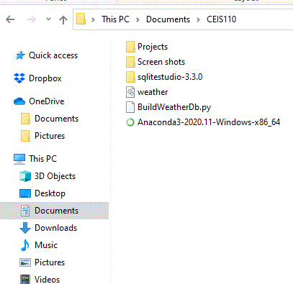
Weather.db File
(Screenshot)
Screenshot of Windows Explorer showing database file Weather.db was created

Slide 8
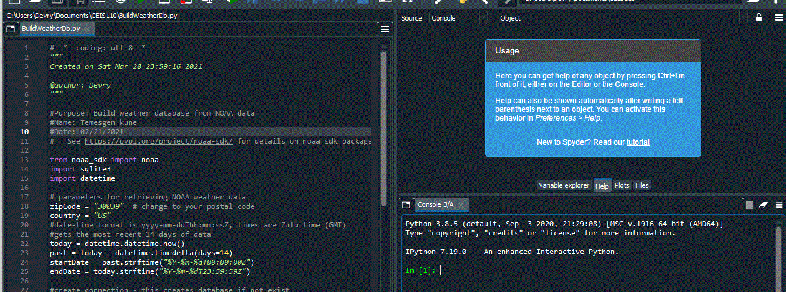
BuildWeatherDb.py Code (Screenshot)
Screenshot of code in Spyder
Must have your name and date in comments
Must have your zip code

Slide 9
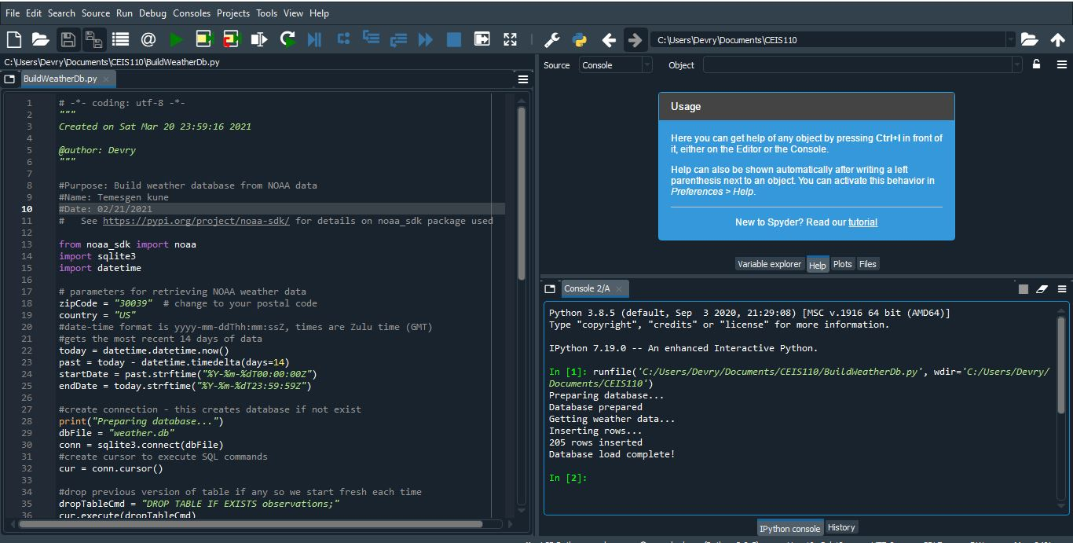
Python Console
(Screenshot)
Screenshot of program output in Python console showing program executed successfully

Slide 10
Step 3
Querying the database with SQL

Slide 11
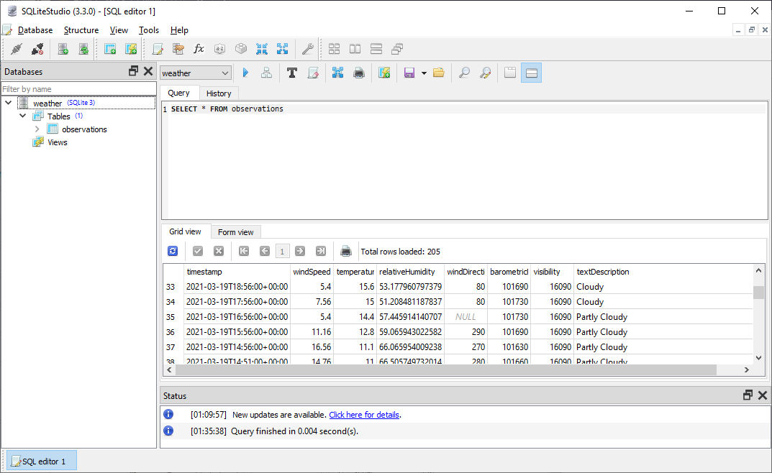
Query to retrieve all columns and all rows (Screenshot)
Screenshot of SQL query command and results

Slide 12
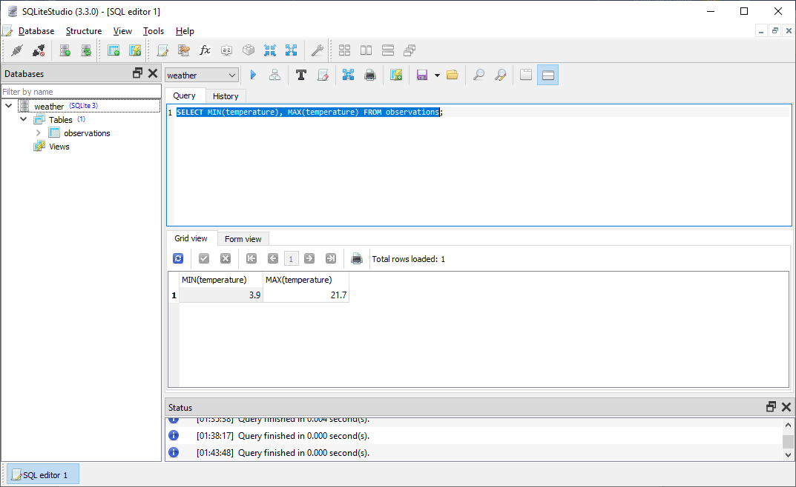
Query to retrieve lowest and highest temperatures
(Screenshot)
Screenshot of SQL query command and results

Slide 13
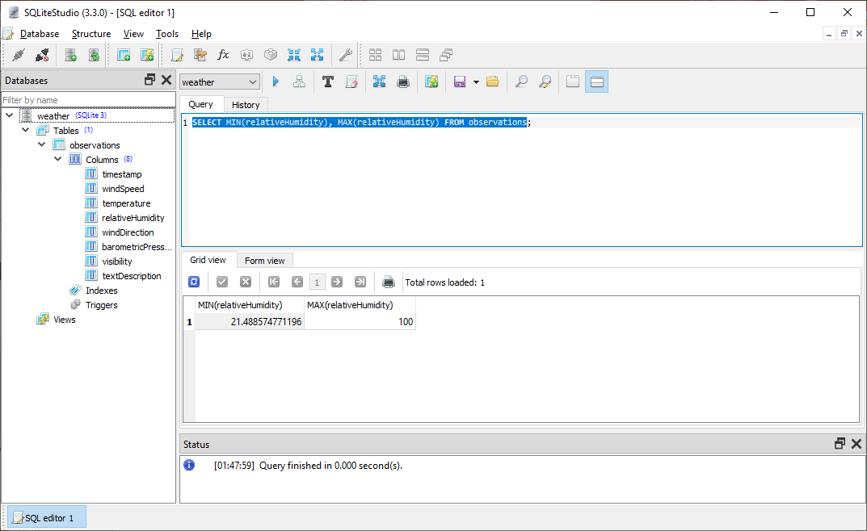
Query to retrieve lowest and highest relative Humidity
(Screenshot)
Screenshot of SQL query command and results

Slide 14
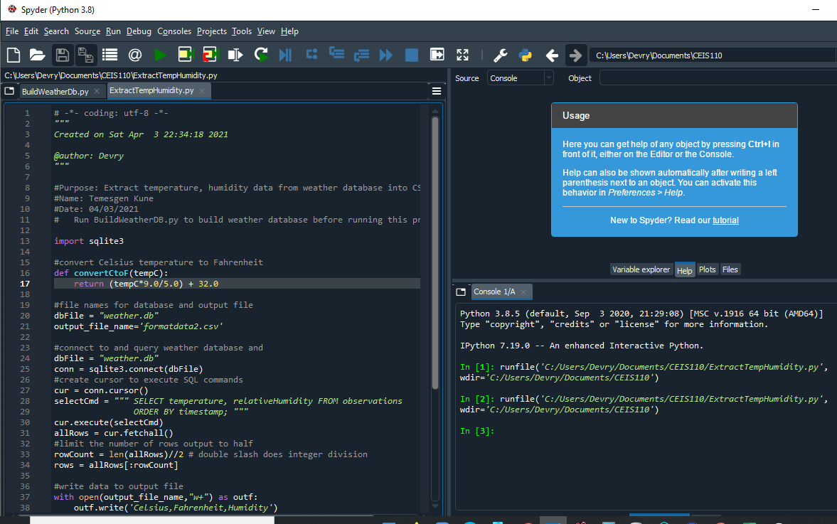
Python code (Screenshot or file)
ExtractTempHumidity.py Python code
with your name and date in comments

Slide 15
Step 4
Querying and Manipulating Data with SQL and Python
Objectives
To retrieve data from a database with an embedded SQL query in Python
To cleanse data and manipulate data from a database in Python
To save data as a CSV file
To open data in Excel and create a chart

Slide 16
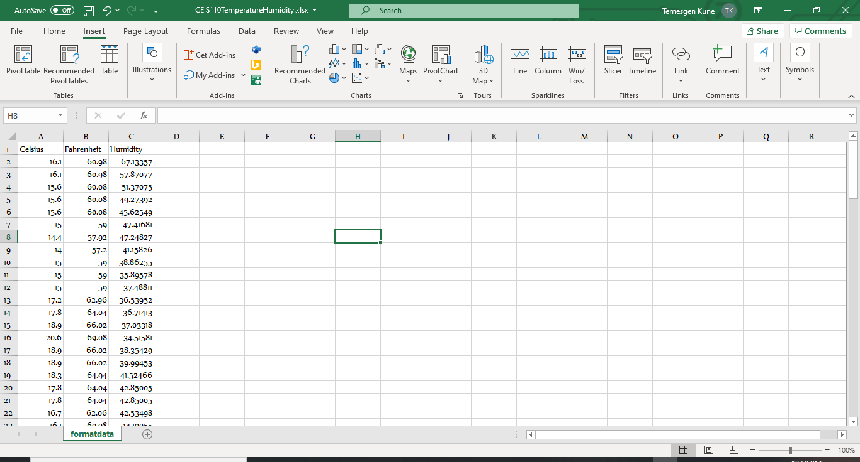
Retrieve and Convert Data to CSV Format (Screenshot)
Format data file open in Excel showing 3 columns of data

Slide 17
Temperature and Humidity Charts (Graph)
Excel chart based on temperature and humidity data from database

Slide 18
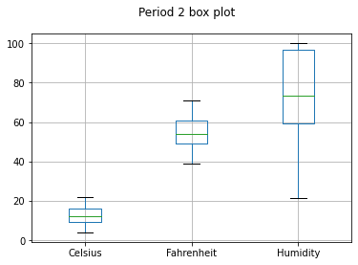
Plot #1
Plot and code used to generate it
Box
Line
Histogram
Scatter
Research your own!
#Purpose: Create box plot for period 2 data
#Name: Temesgen Kune
#Date: 04/10/2021
import pandas as pd
import matplotlib.pyplot as plt
df2 = pd.read_csv("formatdata2.csv")
df2.boxplot(); plt.suptitle('Period 2 box plot')
plt.show()

Slide 19
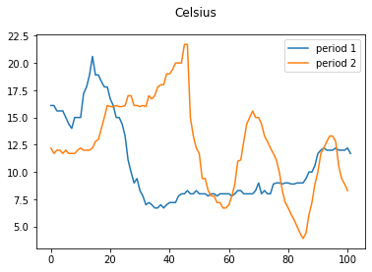
Plot #2
(Screenshots)
Plot and code used to generate it
Box
Line
Histogram
Scatter
Research your own!
#Purpose: Create Celsius plot comparing period 1 and period 2
#Name: Temesgen Kune
#Date: 04/10/2021
import pandas as pd
import matplotlib.pyplot as plt
df1 = pd.read_csv("formatdata.csv") #baseline data is period 1 (older)
df2 = pd.read_csv("formatdata2.csv") #data for period 2 (more recent)
plt.figure(); df1.Celsius.plot(label = 'period 1 '); df2.Celsius.plot(label = 'period 2'); plt.legend(loc='best'); plt.suptitle('Celsius')
plt.show()

Slide 20
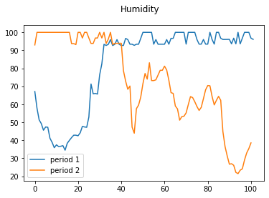
Plot #3
(Screenshots)
Plot and code used to generate it
Box
Line
Histogram
Scatter
Research your own!
#Purpose: Create Humidity plot comparing period 1 and period 2
#Name: Temesgen Kune
#Date: 04/10/2021
import pandas as pd
import matplotlib.pyplot as plt
df1 = pd.read_csv("formatdata.csv") #baseline data is period 1 (older)
df2 = pd.read_csv("formatdata2.csv") #data for period 2 (more recent)
plt.figure(); df1. Humidity.plot(label = 'period 1 '); df2. Humidity.plot(label = 'period 2'); plt.legend(loc='best'); plt.suptitle(' Humidity ')
plt.show()

Slide 21
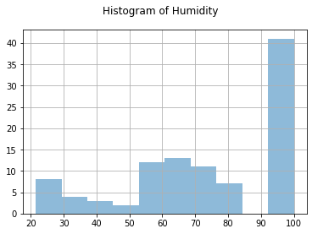
Plot #4
Plot and code used to generate it
Box
Line
Histogram
Scatter
Research your own!
#Purpose: Create a histogram of humidity data from the second period
#Name: Temesgen Kune
#Date: 04/10/2021
import pandas as pd
import matplotlib.pyplot as plt
df1 = pd.read_csv("formatdata.csv")
df2 = pd.read_csv("formatdata2.csv")
df2['Humidity'].hist(bins=10, alpha=0.5); plt.suptitle('Histogram of Humidity')
plt.show()

Slide 22
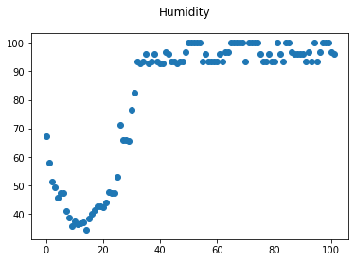
Plot #5
Plot and code used to generate it
Box
Line
Histogram
Scatter
Research your own!
#Purpose: Create scatter plot of humidity for period 1. Can replace df1 to df2 to display second period data
#Name:Temesgen Kune
#Date: 04/10/2021
import pandas as pd
import matplotlib.pyplot as plt
df1 = pd.read_csv("formatdata.csv")
df2 = pd.read_csv("formatdata2.csv")
plt.scatter(df1.index.values,df1['Humidity']); plt.suptitle('Humidity')
plt.show()

Slide 23
Step 5
Querying and Manipulating Data with SQL and Python
Objectives
To retrieve data from a database with an embedded SQL query in Python.
To cleanse data and manipulate data from a database in Python.
To save data as a CSV file.
To open data in Excel and create a chart.

Slide 24
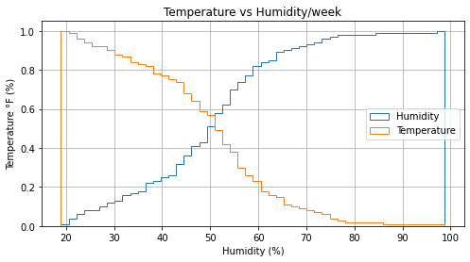
Analysis
Think of your own question and create a chart/graph to answer it.
What is the relation between Humidity and Temperature?
Answer supported by Chart:
As the line chart shows Humidity and temperature are inversely proportional.

Slide 25
Code
# plot the cumulative histogram
n, bins, patches = ax.hist(x, n_bins, density=True, histtype='step',
cumulative=True, label='Humidity')
# Add a line showing the expected distribution.
y = (((np.sqrt(2 * np.pi) * sigma)) *
np.exp(5 * (sigma * (bins + mu))*2))
y = y.cumsum()
y /= y[-1]
# Overlay a reversed cumulative histogram.
ax.hist(x, bins=bins, density=True, histtype='step', cumulative=-1,
label='Temperature')
# tidy up the figure
ax.grid(True)
ax.legend(loc='right')
ax.set_title('Temperature vs Humidity/week')
ax.set_xlabel('Humidity (%)')
ax.set_ylabel('Temperature °F (%)')
plt.show()
#Purpose: Create Temperature vs Humidity in a week
#Name: Temesgen kune
#Date: 04/10/2021import matplotlib
matplotlib.axes.Axes.hist
matplotlib.pyplot.hist
import numpy as np
import matplotlib.pyplot as plt
np.random.seed(19680)
mu = 50
sigma = 15
n_bins = 50
x = np.random.normal(mu, sigma, size=100)
fig, ax = plt.subplots(figsize=(8, 4))

Slide 26
Prediction
Develop a prediction based on the data. What variations in temperature and humidity do you expect over the next few hours or days? How would humidity change if temperature goes up or down?
From the chart above we can predict that whenever Temperature rises, Humidity gets down and down. Since there is inverse relation between Temperature and Humidity, we can follow the pattern of the chart to predict both Temperature and Humidity.
It is obvious that there are times when Temperature and Humidity can have the same vale for some days but not most the time.

Slide 27

Challenges
Syntax errors when typing.
Data inconsistency

Slide 28
Career skills obtained
Python programming.
Data analysis.
Troubleshooting errors in coding

Slide 29
Conclusion
As a beginner, it is an amazing experience that coding in python project.
good understanding of coding in the real world.
The project is hands on training for beginner programmers and introduces programing languages .
Experience of Analyzing data

