Slide 1
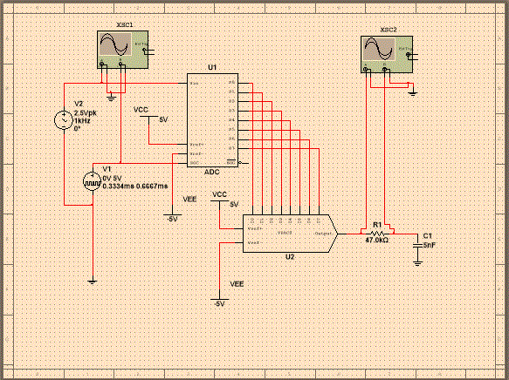
NETW310 Wired, Optical and Wireless Communication with Lab
By; Temesgen Kune Oct,2021
Notes:
NOTE:
To change the image on this slide, select the picture and delete it. Then click the Pictures icon in the placeholder to insert your own image.

Slide 2
Introduction
Exploring the capabilities of a spectrum analyzer and an oscilloscope for analyzing the time-domain and frequency domain characteristics of a square wave signal.
Simulating a PCM system and comparing the original input signal at the transmitter to the recovered signal at the receiver as well as plotting the power spectral densities of common line codes and comparing their required frequency spectrum.
Network cabling installation standards used in structured cabling systems for multimedia communication.
Analyzing the relationship between the signal frequency, antenna size, and antenna gain as well as analyzing the relationship between the signal frequency, distance, and free space path loss.
Exploring and analyzing the BER performance of wireline and optical channels that use FSK, PSK, and DPSK as well as exploring and analyzing the BER performance of wireless channels that use PSK.

Slide 3
Baseband Signals
The screenshot should show the spectrum analyzer displaying the signal’s harmonic spectrum and its panel settings. Record the signal voltage at each of the frequencies in the table.
SCREENSHOT HERE
Harmonic Frequency | Signal (Volts)
20 kHz | 2.281V
40 kHz | 38.08mV
60 kHz | 765.244mV
80 kHz | 26.358mV
100 kHz | 395.904mV

Slide 4
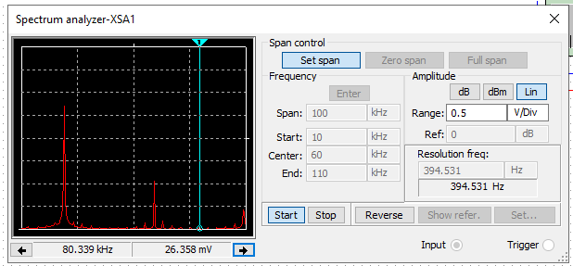
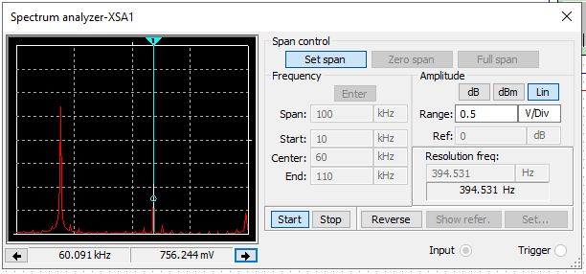
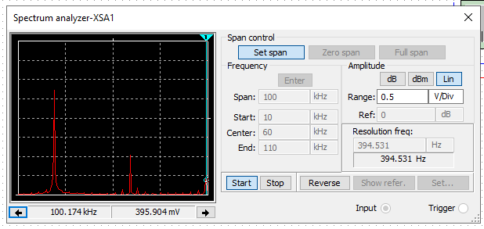
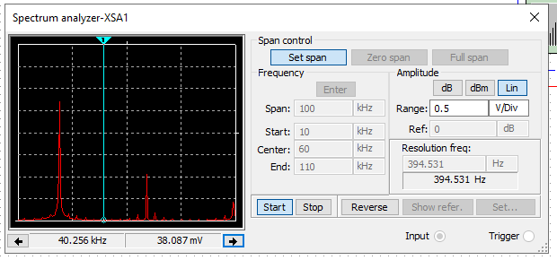
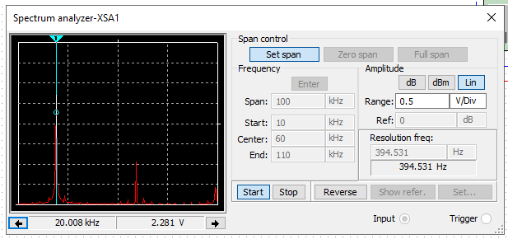
Additional screen shots

Slide 5
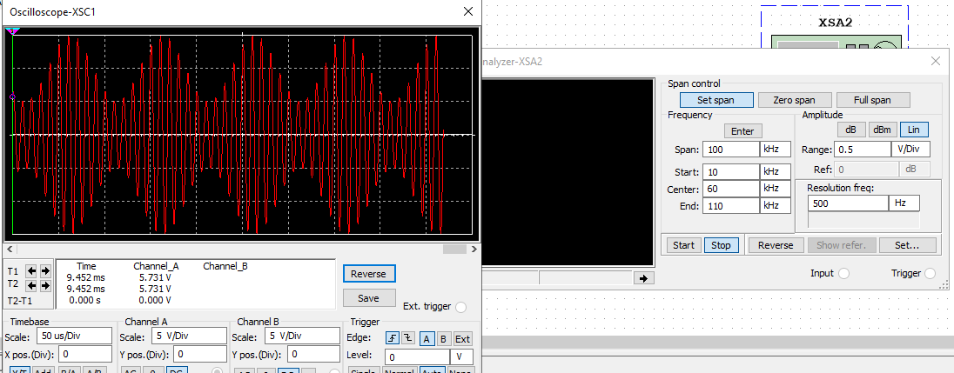
AM Signals
The screenshot of the Oscilloscope should include the signal and the panel settings of the oscilloscope. The screenshot of the Spectrum Analyzer should include the signal and the panel setting of the analyzer.
Oscilloscope screenshot here
Spectrum Analyzer screenshot here
AM Modulation | Frequency (kHz)
Lower side band | 1.02kHz
Carrier | 97.07khz
Upper side band | 51.76kHz

Slide 6
AM Signals Cont.
Develop equations for the carrier and modulating signals and plot the equation for the composite modulated signal V_{AM .}
Equations here:
Vc=Vp sin(2πfct+θc), Vi= Vp sin(2πft+θi) Assume θc and θi=0
VAM= [Vc+Vpsin(2πfct+θc)][sin(2πft+θi)]
Plotted diagram screenshot here:

Slide 7
FM Signals
The screenshot of the Oscilloscope should include the signal and the panel settings of the oscilloscope. The screenshot of the Spectrum Analyzer should include the signal and the panel setting of the analyzer.
Oscilloscope screenshot here
Spectrum Analyzer screenshot here
What’s the carrier frequency?
15.183-3.721=11.462
11.462

Slide 8
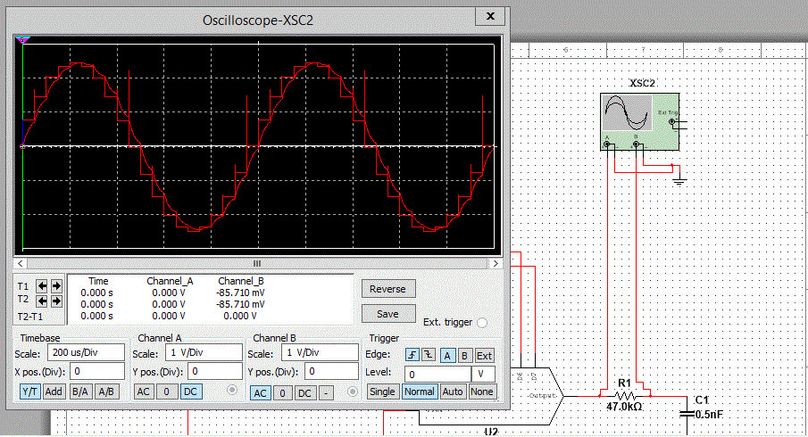
Pulse Code Modulation (PCM)
The first screenshot should show the Oscilloscope-XSC1 display with the analog input signal and sampling clock at the input to the ADC. The second screenshot should show the Oscilloscope-XSC2 display with the output of the DAC.

Slide 9
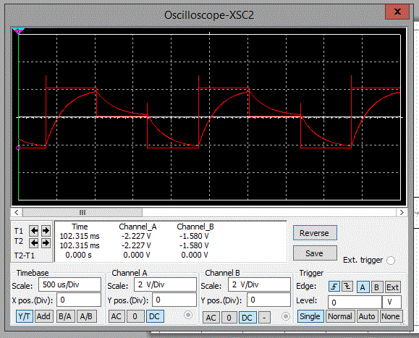
Pulse Code Modulation (PCM)
The first screenshot should show the Oscilloscope-XSC1 display with the analog input signal and sampling clock at the input to the ADC. The second screenshot should show the Oscilloscope-XSC2 display with the output of the DAC.
What are the effects of increasing or decreasing the sampling rate?
Answer: Changes of Direction and Sampling rate differences.

Slide 10
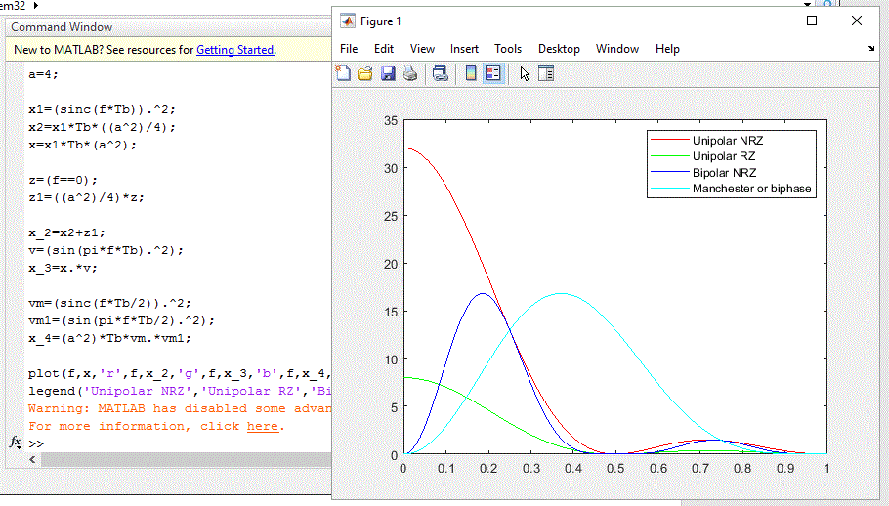
Line Codes
This screenshot should show the power spectral densities of four-line codes: NRZ-Polar, NRZ-Unipolar, NRZ-Bipolar, and Manchester-Polar.
Compare the NBR-Polar and Manchester polar codes in the diagram.
Which one requires more bandwidth?
Answer: Unipolar NRZ requires more bandwidth whereas Manchester polar codes have highest Bandwidth. Unipolar NRZ has a Direct Current (DC) component whereas the Manchester polar codes has no energy at DC.

Slide 11
Questions
1. Why must the twisting in the individual wires be maintained in a UTP cable?
Answer: 1. We twist cables because of physical endurance and mechanical performances.
2. Safe data transmission (crosstalk and electromagnetic interference).
2. How many inches should UTP cable be separated from 110 volts electrical cable?
Answer: UTP cables should be two or more inches away from electrical cable
3. Horizontal cabling connects what areas to each other?
Answer: Horizontal Cabling connects equipment room to work areas.

Slide 12
Questions
4. What is a plenum rated cable?
Answer: Plenum rated cable is fire-resistant rated and Communications multipurpose cable, Plenum cable.
Hyperlink: https://www.cablewholesale.com/support/technical_articles/confusing_cable_terms.php
5. What is a riser tube used for?
Answer: 1.A riser tube holds twisted pair cable in place through all the building.
2. Prevents data loss and cross-talk.
6. Is the grounding of equipment mostly a safety or a performance concern?
Answer: Grounding of Equipment is both safety and Performance.
When coming to safety, if equipment not grounded, it can cause shock hazard. Grounding also helps in performance regarding tight holding plug in place and some plugs does not work if the grounding knob broken.

Slide 13
Antenna Gain
1. What is the maximum theoretical antenna gain of a common dish antenna at the 2.4 GHz band?
Answer:22.379
2. What is the maximum theoretical antenna gain of a common dish antenna at the 5 GHz band?
Answer:29.079
3. Given the same sized reflector, which signals, high-frequency, or low-frequency, can be more efficiently focused by a common dish antenna (i.e., result in a higher antenna gain)?
Answer: High-frequency signals are more efficiently focused.
4. What is the maximum theoretical antenna gain of the dish antenna used in the VLA radio telescopes in New Mexico at the 5 GHz band?
Answer: 63.059
5. Given the same signal frequency, which dish antennas, large-sized or small-sized, are more efficient at focusing the signal (i.e., result in a higher antenna gain)?
Answer: Large-sized dish antennas are more efficient at focusing.

Slide 14
Free Space Path Loss
1. What is the free space path loss in dB at the 2.4 GHz band?
Answer:-80.4dB
2. What is the free space path loss in dB at the 5 GHz band?
Answer:-87.2dB
3. How does the free space path loss at a higher frequency (e.g., the 5 GHz band) compare with that at a lower frequency (e.g., the 2.4 GHz band)?
Answer: Free space path loss at higher frequency (the 5 GHz band) is lower than lower frequency path loss (the 2.4 GHz band). When frequency increase the path loss decrease.
4. What is the free space path loss in dB over 20 meters at the 2.4 GHz band?
Answer: -66.421dB
5. What is the free space path loss in dB over 40 meters at the 2.4 GHz band?
Answer: -72.441dB
6. What is the free space path loss in dB over 80 meters at the 2.4 GHz band?
Answer: -78.462
7. When the distance doubles, how does free space path loss in dB change approximately?
Answer: When distances doubles, the loss increases which is lower decibels.

Slide 15
Free Space Path Loss.
8. Use a scientific calculator to calculate Delta $L_{fS}$ for D1 = 20 meters and D2 = 40 meters. [4 points]
Delta $L_{fS }$= 20log(D1/D2)
=20log(20/40)
=20log(0.5)
= -6.021
9. Is your calculation approximately the same as the result from Part 1 Step 2? [4 points]
Answer: Yes. There is the same result
Explanation
(4. What is the free space path loss in dB over 20 meters at the 2.4 GHz band? [4 points]
Answer: -66.421dB
5. What is the free space path loss in dB over 40 meters at the 2.4 GHz band? [4 points]
Answer: -72.441dB)
= -72.441 (-*) -66.421= -6.021
*The math concept of takes different concept here.

Slide 16
AWGN Channel and Rician Channel
This screenshot shows the bit rate error performance of both AWGN and Rician fading channels.

Slide 17
AWGN Channel and Rician Channel
Compare and contrast the BER performance of PSK over a noise limited (AWGN) transmission channel to the performance of PSK over a Rician channel at 5- and 10-dB Signal to Noise Ratio (E_{b}/N₀), respectively.
Is there a significant difference in BER performance of PSK between the AWGN channel and Rician channel?
Answer: There is big difference in PER between AWGA-PSK and Rician-PSK. When signal to noise ratio increase, AWGA-PSK showed higher decreases rate of PER than Rician-PSK. Rician-PSK shows in-significant decrease in PER in increased signal to noise ratio.(E_{b}/N₀).

Slide 18
Challenges
Labs are on remote desktop.
Time management
Personal challenges

Slide 19
Career Skills Acquired
Telecommunication skills and barriers of communication.
Hardware and Software Knowledge in communication world.
How Antenna works .
Spectrum analyzing and an oscilloscope analyzing
Input and output devices.
Frequency and measurements.

Slide 20
Conclusion
This project introduced me with good understanding of Communication systems and devices as well as how things works in the real world like Radios and TVs .
The project is hands on training for beginner IT techs.

