Slide 1
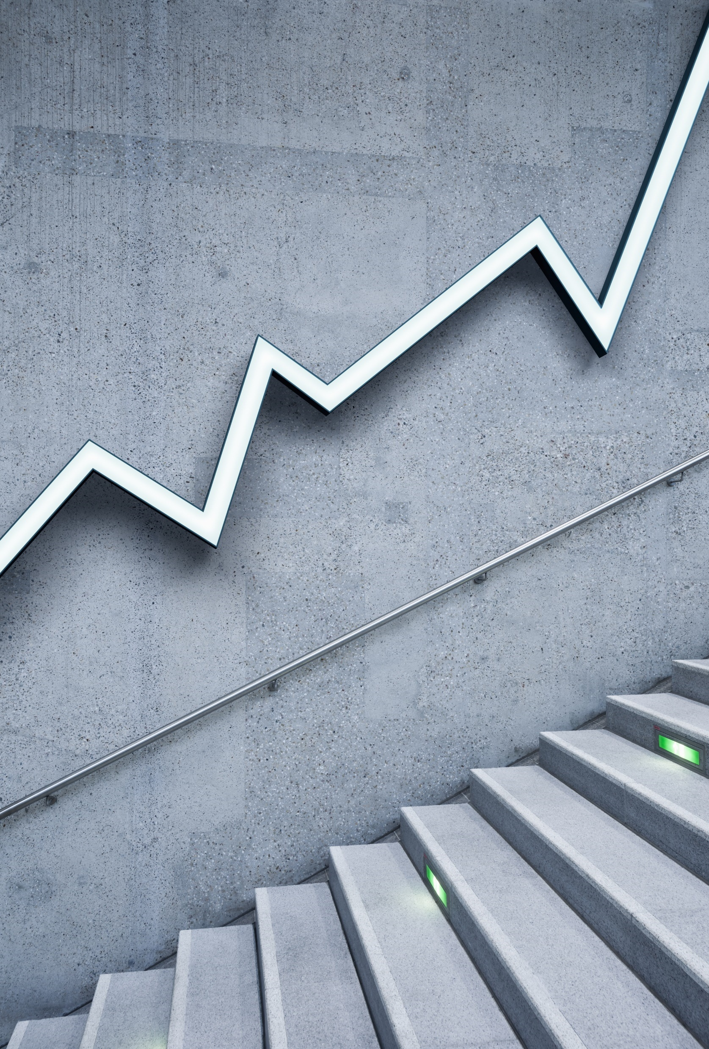
Applied Physics with Lab
DeVry University
PHYS204
Feb 2022, Temesgen Kune

Slide 2
Introduction
Physics takes main portion of our day-to-day life.
The best way to learn physics is to do physics.
Scientific experiment developed to investigate the fundamental laws of physics culminating in a formal lab report.
The modules are based on the scientific methods and the development process includes critical thinking, hardware setup, and programming.
There are six modules in this project.

Slide 3
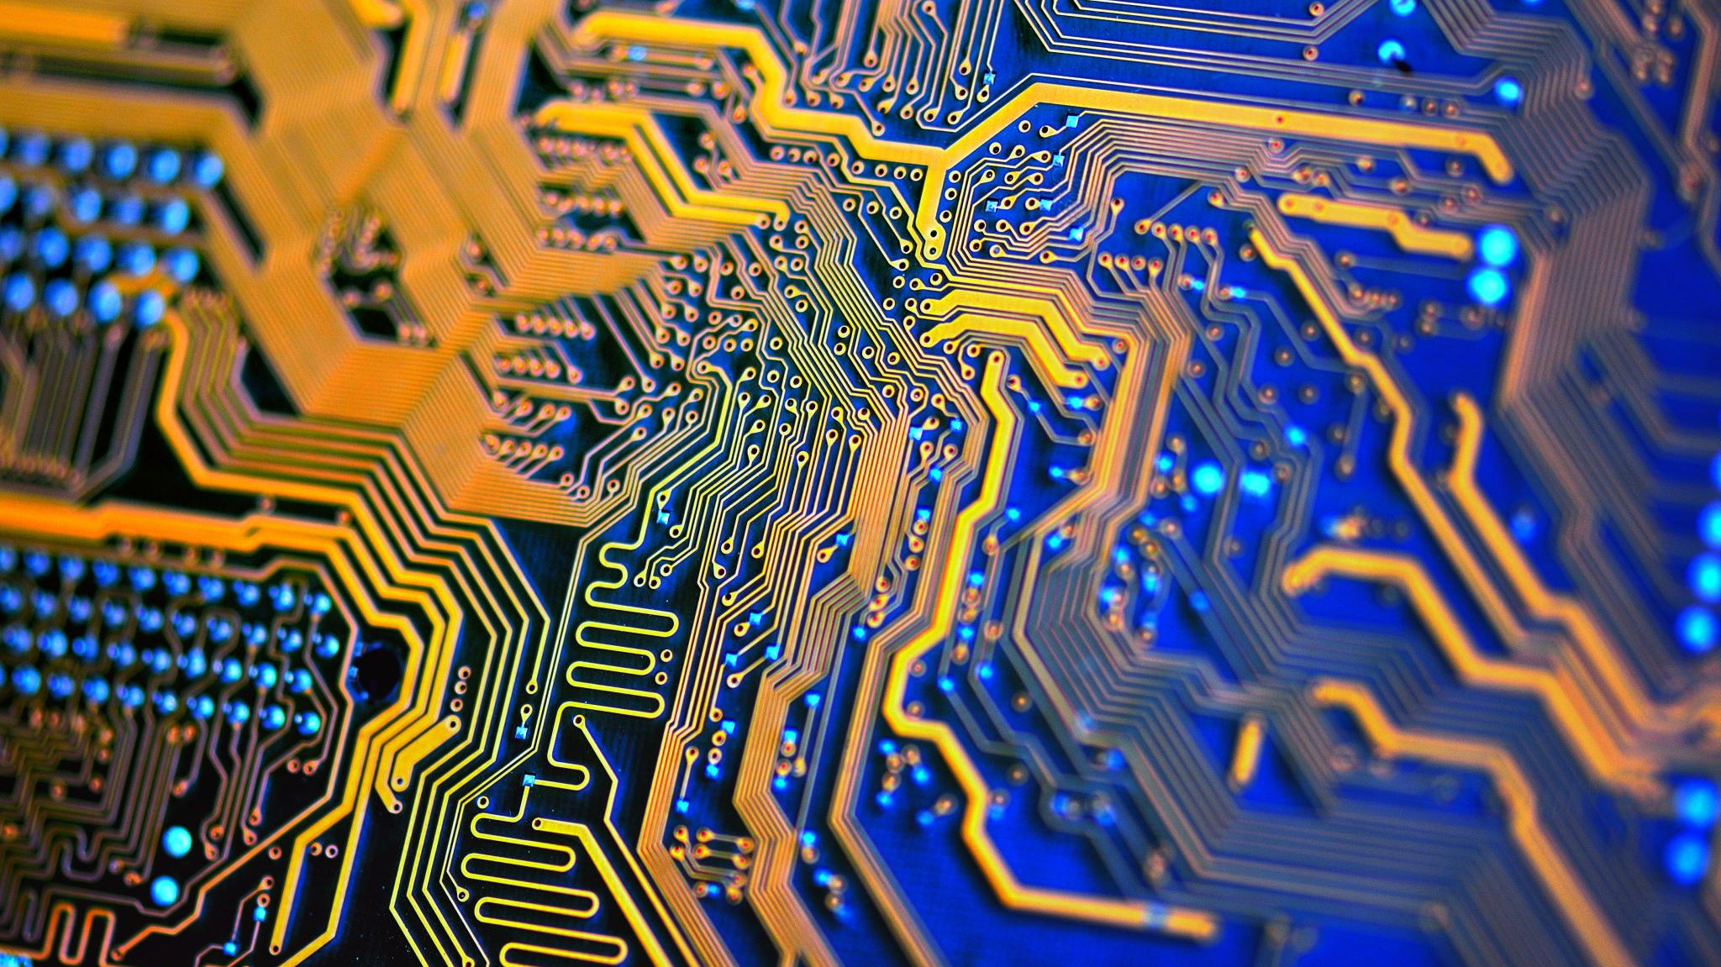
Module 1
Materials List

Slide 4
Part 1: Inventory of Parts
Will organize the parts needed to conduct the experiments.
The materials list is a vital component of any formal lab report.
Description of exactly what you need to conduct an experiment.
Objectives
To introduce the course project and scientific method.
To generate a material parts lists needed to observe the laws of physics.
To download necessary software to run scientific experiments .

Slide 5
Materials List (Picture)
Mega 2560 Board
Ultrasonic sensor HC-SR04
Male to Male Wires
Breadboard
USB cable
Ruler or tape measurer
Object to act as obstacle and/or undergo free-fall

Slide 6
Materials List (Picture)
Mega 2560 Board
Rotary Encoder Module KY-040
Male to Female Wires
USB cable
Object to attach onto rotary encoder
Ruler or tape measurer

Slide 7
Materials List (Picture)
ESP32 microprocessor
Micro-USB to USB cable
Magnet

Slide 8
Required Software (screenshot)
Microsoft Excel installed and running on your computer

Slide 9
Required Software (screenshot)
Arduino IDE installed and running on your computer

Slide 10
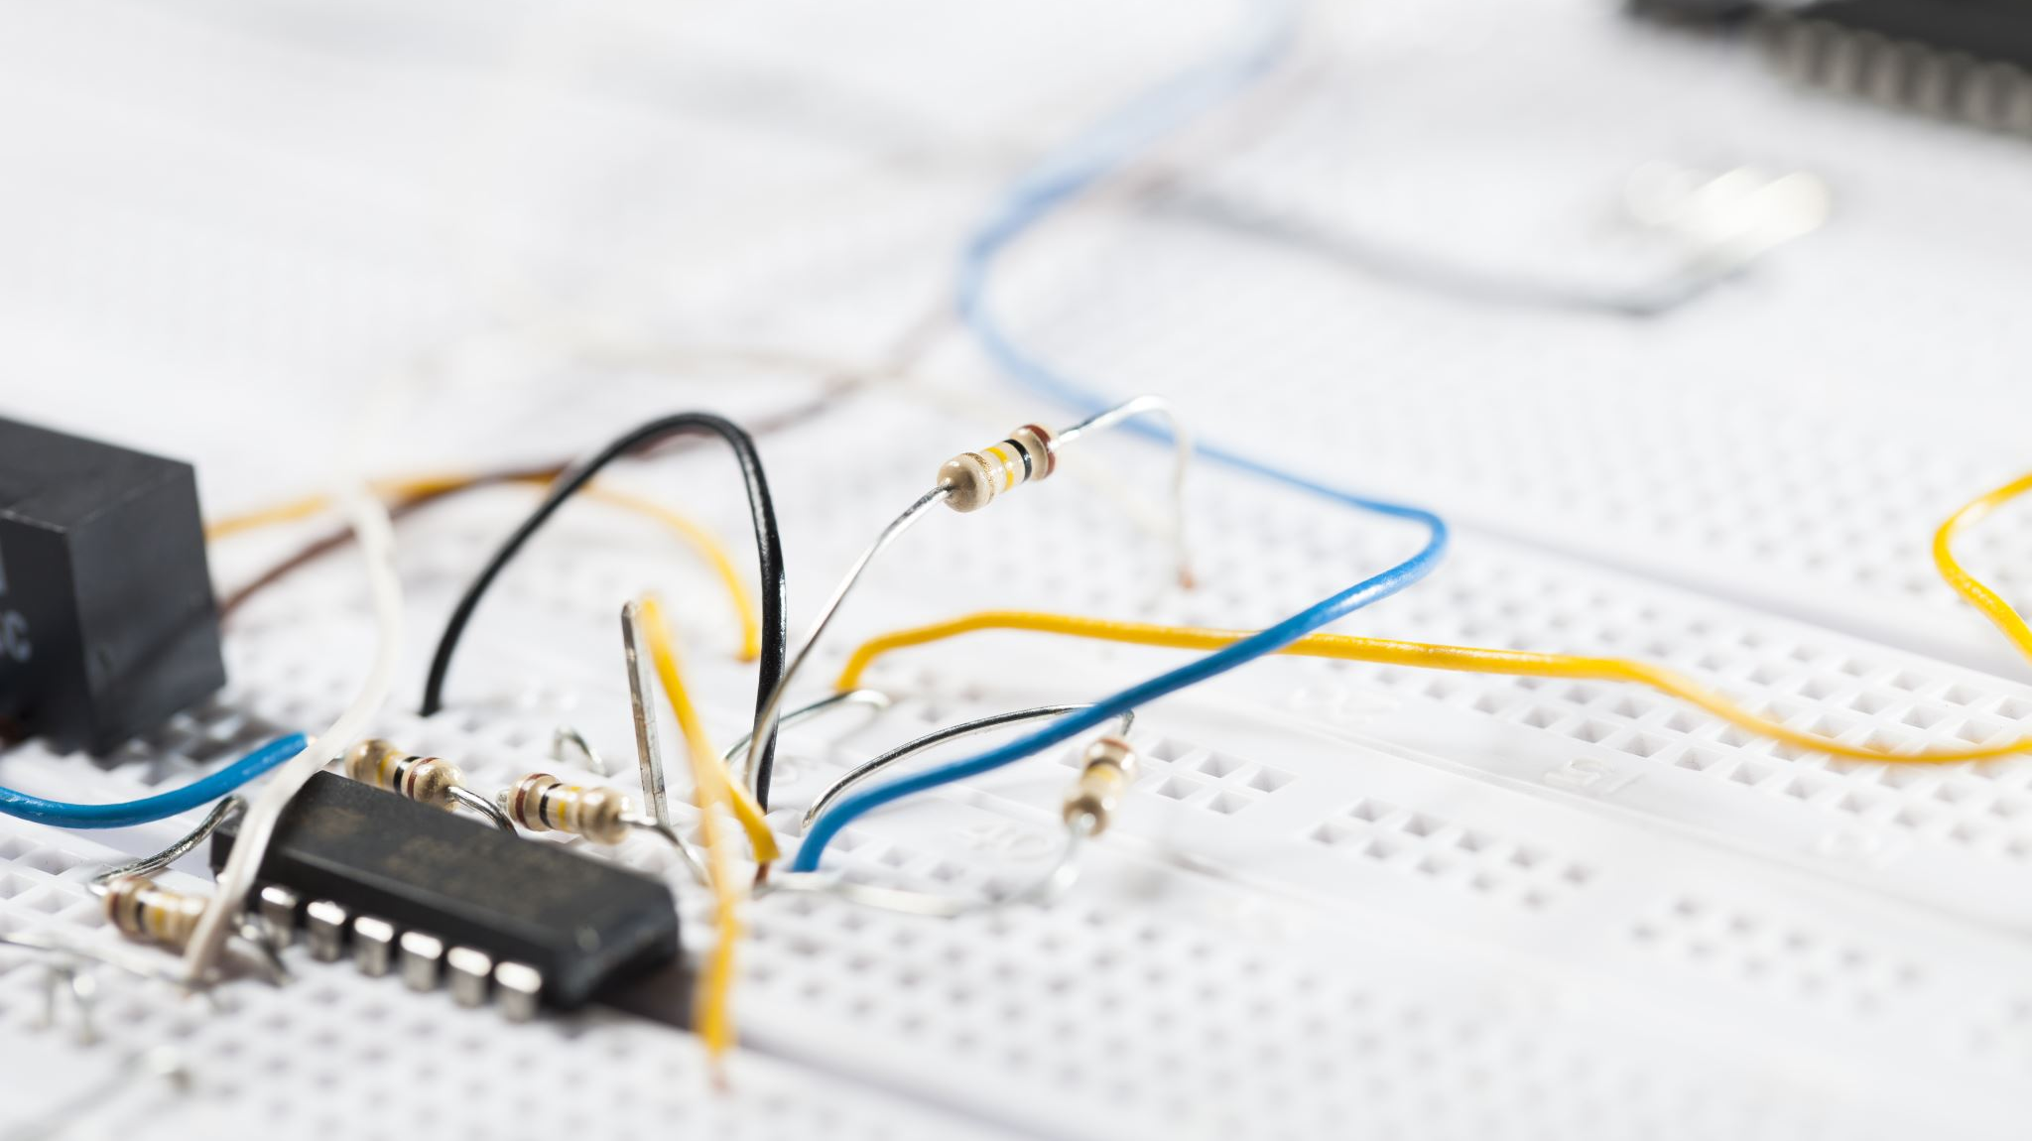
Module 2
Precision of the Ultrasonic Sensor

Slide 11
Objectives
To generate an experimental set up to observe the laws of physics
To test the precision of the ultrasonic sensor
To train in scientific method of observation
To acquire experience handling of electronics equipment
To collect scientific data
To compute reliable results and draw valid conclusions from data

Slide 12
Materials List (Picture)
Mega 2560 Board
Ultrasonic sensor HC-SR04
Male to Male Wires
Breadboard
USB cable
Ruler or tape measurer
Object to act as obstacle and/or undergo free-fall

Slide 13
Materials Setup
Mega 2560 Board
Ultrasonic sensor HC-SR04
Male to Male Wires
Breadboard
USB cable
Ruler or tape measurer
Object to act as obstacle

Slide 14
Raw Data (Screenshot)
Screenshot of Serial Monitor from Arduino IDE showing raw data.
Must include your name displayed in the serial monitor.

Slide 15
Data Collection
Trial | Ruler Distance (cm) | Total Roundtrip Distance (m) | Time from Serial Monitor (microseconds) | Roundtrip time (s) | Velocity = distance/time (m/s)
1 | 8 | .16 | 443 | 4.43e⁻⁴ | 361.2
2 | 6 | .12 | 394 | 3.94e⁻⁴ | 304.6
3 | 10 | .20 | 564 | 5.64e⁻⁴ | 354.6
4 | 4 | .08 | 185 | 1.85e⁻⁴ | 432.4
5 | 12 | .24 | 675 | 6.75e⁻⁴ | 355.6

Slide 16
Data Analysis
Average velocity from table
=(361.2+304.6+354.6+432.4+355.6)/5=361.7m/s
Percent difference where $v_{sound}=343 m/s$
$$v_{avg}= \frac{v_{1}+v_{2}+v_{3}+v_{4}+v_{5}}{5}=$$
$$Percent difference = \frac{\left|v_{avg}−v_{sound}\right|}{v_{sound}}×100\%$$
|361.7- $343$|/$343$ x 100% = 5.45%
Note: Use meters and seconds for all calculations. Show the appropriate units for measured and calculated values

Slide 17
Conclusions
Discuss the results
Answer: The collected data shows different precision of the Ultrasonic Sensor for different distances of obstacle objects.
The calculated sound speed of Ultrasonic Sensor is close to the speed of sound in air.
Comment on the source of errors.
Some sources of errors would be:
The humidity of the room
Air temperature of the room
Conversion and measurement errors.
What is the dependence of temperature, humidity and atmospheric pressure on the speed of sound?
Answer: When there is higher room temperature, the faster sound transmission and the reverse true.
The higher the humidity, slower sound transmission, lower the humidity faster sound transmission.
Where there is higher atmospheric pressure, there is faster sound transmission, and the reverse is also true.

Slide 18
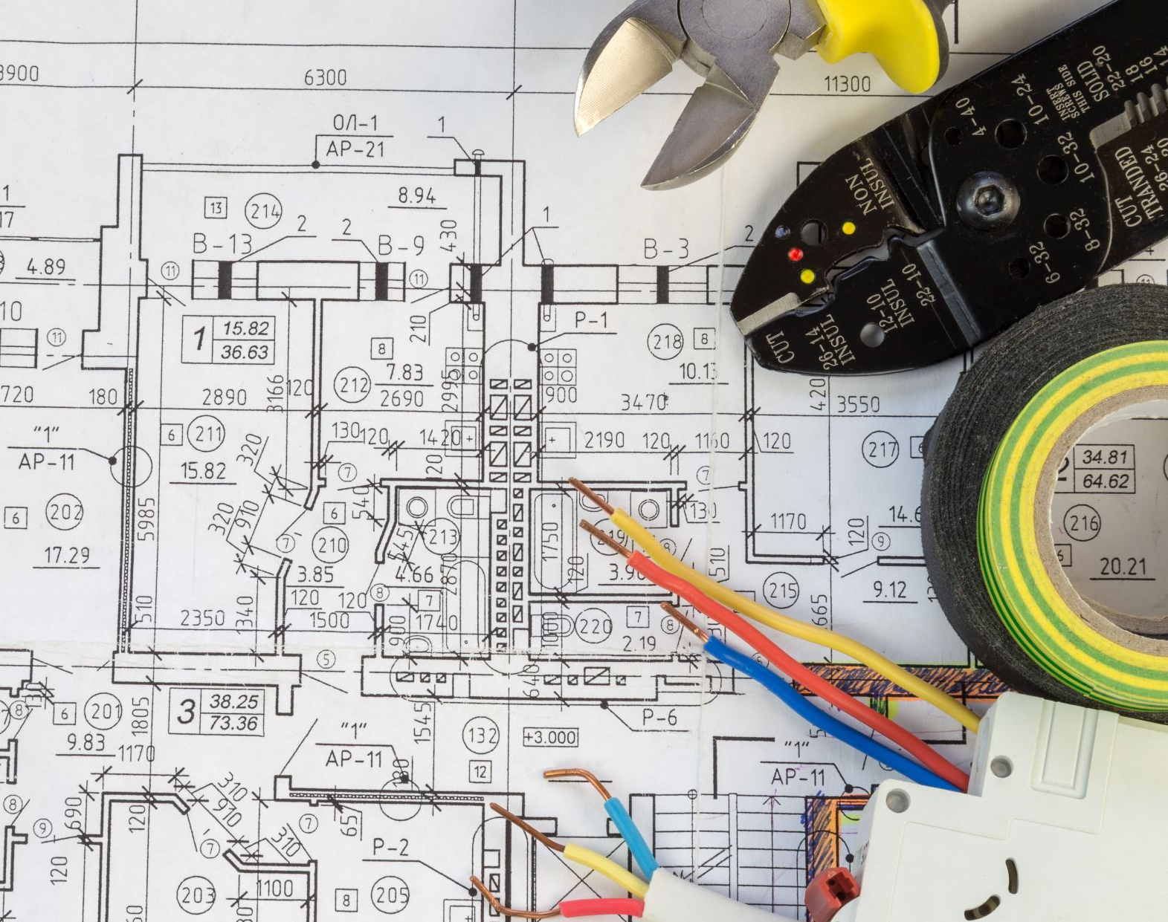
Module 3
Gravitational Acceleration

Slide 19
Objectives
To generate an experimental set up to observe the laws of physics.
To determine the value of the acceleration due to gravity of a free-falling object.
To train in scientific method of observation.
To acquire experience handling of electronics equipment.
To collect scientific data.
To compute reliable results and draw valid conclusions from data.

Slide 20
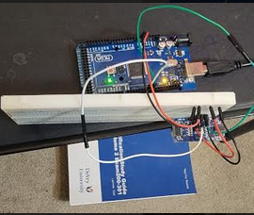
Experimental Set-up (Top view)
Materials List:
Mega 2560 Board
Ultrasonic sensor HC-SR04
Male to Male Wires
Breadboard
Object to undergo free fall motion

Slide 21
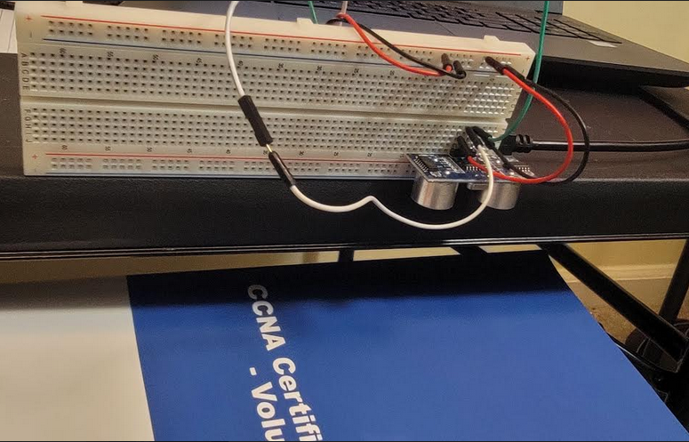
Experimental Set-up (Side View)
Materials List:
Mega 2560 Board
Ultrasonic sensor HC-SR04
Male to Male Wires
Breadboard
Object to undergo free fall motion

Slide 22
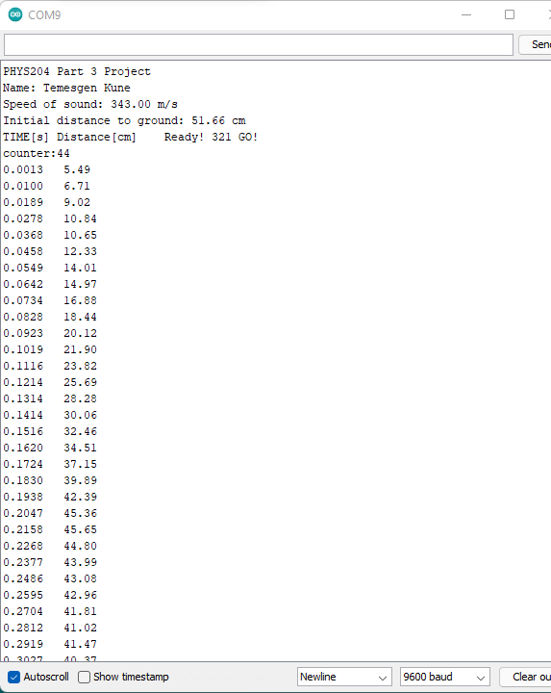
Serial Monitor (Screenshot)
Include screenshot of raw data showing the start of the fall and end of the fall of one trial.
Must include your name displayed in the serial monitor.
Make sure “show timestamp” is NOT selected.
Data: Increasing Values

Slide 23
Excel Table (Screenshot)
Include all values in the Excel table for a single trial showing the fall distance in centimeters and meters as a function of time

Slide 24
Excel Graph (Screenshot)
Include Excel graph for a single trial showing the fall distance as a function of time.
Must include equation for curve fitting.

Slide 25
Data Collection
Trial | x² coefficient value from curve fitting | Acceleration (m/s²) = 2* (x² coefficient)
1 | 1.31 | 2.62
2 | 8.24 | 16.48
3 | 3.7 | 7.4
4 | 4.46 | 8.92
5 | 2.72 | 5.44

Slide 26
Data Analysis
Average acceleration from table
Percent difference with $g=9.8 m/s^{2}$
$a_{avg}= \frac{2.62+16.48+7.4+8.92+5.44}{5}$ =8.17 m/s²
$$a_{avg}= \frac{a_{1}+a_{2}+a_{3}+a_{4}+a_{5}}{5}$$
$Percent difference =\frac{\left|a_{avg}−g\right|}{g}×100=$ $\frac{\left|8.17−9.8\right|}{9.8}$ $×100$= 16.6%
Note: Use meters and seconds for all calculations. Show the appropriate units for measured and calculated values

Slide 27
Conclusions
Discuss the results and comment on the source of errors.
Answer: Some sources of errors are:
Height of ultra sonic sensor from the ground
The size of Object to undergo free fall motion
The angle of free fall
Unstable data chosen
Disconnection of Wires from mega board, and bread board
Miscopied code from original code.
Arduino failure to upload the code
How much variation is there from trial to trial? What does this indicate about the uncertainty of the result?
Answer: There are variations from trial to trail depending on how fast the object dropping or falling and how the sensor senses in a give time frame.

Slide 28
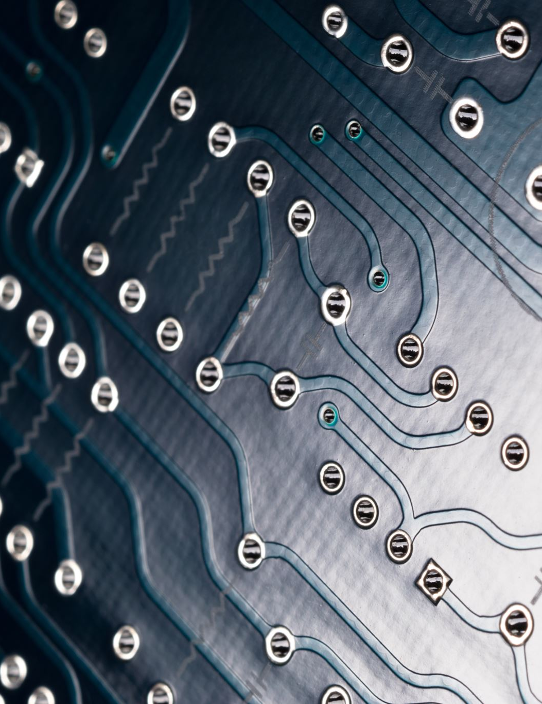
Module 4
Conservation of Energy of Free-Falling Object from Module 3 data.

Slide 29
Objectives
To represent the motion of an object through graphs of position and velocity versus time
To observe the changes in potential energy, kinetic energy, and total mechanical energy of a freely-falling body
To determine both theoretically and experimentally whether the total mechanical energy of a freely-falling body remains constant

Slide 30
Excel Table (Screenshot)
Include all values in the Excel table for a single trial showing the fall distance in centimeters and meters as a function of time with the values generated for kinetic energy K, potential energy U, and total mechanical energy E.

Slide 31
Excel Graph (Screenshot)
Include Excel graph for a single trial showing the plots of the kinetic energy K, potential energy U, and total mechanical energy E as a function of time.
Must include your name in the title of the graph.

Slide 32
Data Validation
Theoretical value of final velocity.
Final velocity from experimental data (or largest velocity)
Percent difference
$h=\text{0.4548}−\text{0.1185}$= 0.3363 m
$v_{f}=\sqrt{2gh}$ = $\sqrt{2∗9.8∗0.3363}$ m/s= 2.57 m/s
$v_{experimental}$ = 2.41 m/s
$$Percent difference =\frac{\left|\text{2.57}−\text{2.41}\right|}{\text{2.41}}×100$$
Answer: 6.64 %

Slide 33
Conclusions
Discuss the key characteristics of the plot. Consider the times when 1.potential energy U is max and min,
When potential energy U is at max level, the kinetic energy K is at minimum level.
2.when kinetic energy K is max and min, and
When Kinetic energy K is max, the potential energy U is tended to decrease to zero value.
3.when U and K are the same value. what is the significance of these points?
When U and K are at the same value, it is called equilibrium because the values are equal and there would be constant Mechanical Energy or Energy is conserved. The point shows E=U+KE=constant is where there are no non conservative forces applied on the object.

Slide 34
Conclusions
What is the trend of the best fit line for the total energy E in your data? The total energy “E” slightly decreasing.
If the data is accurate, the total mechanical energy should decrease slightly. Why is that?
Answer: Because the velocity is decreasing due to other external forces like gravitational force and there is air resistance when the free falling.

Slide 35
Module 5
Rotational Motion

Slide 36
Objectives
To generate an experimental set up to observe the laws of physics.
To apply the arc length formula to measure linear displacement

Slide 37
Materials List (Picture)
Mega 2560 Board
Rotary Encoder Module KY-040
Male to Female Wires
USB cable
Object to attach onto rotary encoder
Ruler or tape measurer

Slide 38
Experimental Set-up
Materials List:
Mega 2560 Board
Rotary Encoder Part KY-040
Male to Female Wires
Object to attach onto rotary encoder (e.g. cork, bottle cap, ball)
Ruler or tape measurer

Slide 39
Raw Data (Screenshot)
Screenshot of Serial Monitor from Arduino IDE showing raw data.
Must include your name displayed in the serial monitor.

Slide 40
Data Collection
Object diameter: d = 2.2cm
Object radius: r = 1.1cm
Number of pulses for one revolution: x = 40
Resolution = $\left(\frac{1 }{x } \frac{Revolution}{pulses}\right)∙\left(\frac{2∙π radians}{1 Revolution}\right)=$0.157rad/pulse

Slide 41
Data Analysis
Trial | Number of pulses N | Encoder distance r$∙Resolution∙$ N | Measured distance with ruler | Percent difference %
1 | 54 | 9.3 | 11 | 15.4
2 | 68 | 11.7 | 14 | 16.4
3 | 83 | 14.3 | 18 | 20.5
4 | 78 | 13.5 | 16 | 15.6
5 | 49 | 8.4 | 10 | 16

Slide 42
Conclusions
Discuss the results and comment on sources of error.
Answer: Some sources of errors might be the rolling surface;
The other error source could be the sliding error instead of rolling.
The object time that not match with the surface or bumpy ends on object.
What are some applications of this measuring technique? Could this measuring system be used to measure surfaces that are not flat?
Answer: Automated rolling machines might help to measure the rotation.

Slide 43
Module 6
Hall Effect

Slide 44
Objectives 1.To generate an experimental set up to observe the laws of physics 2.To observe the Hall effect as a relationship between voltage and magnetic field

Slide 45
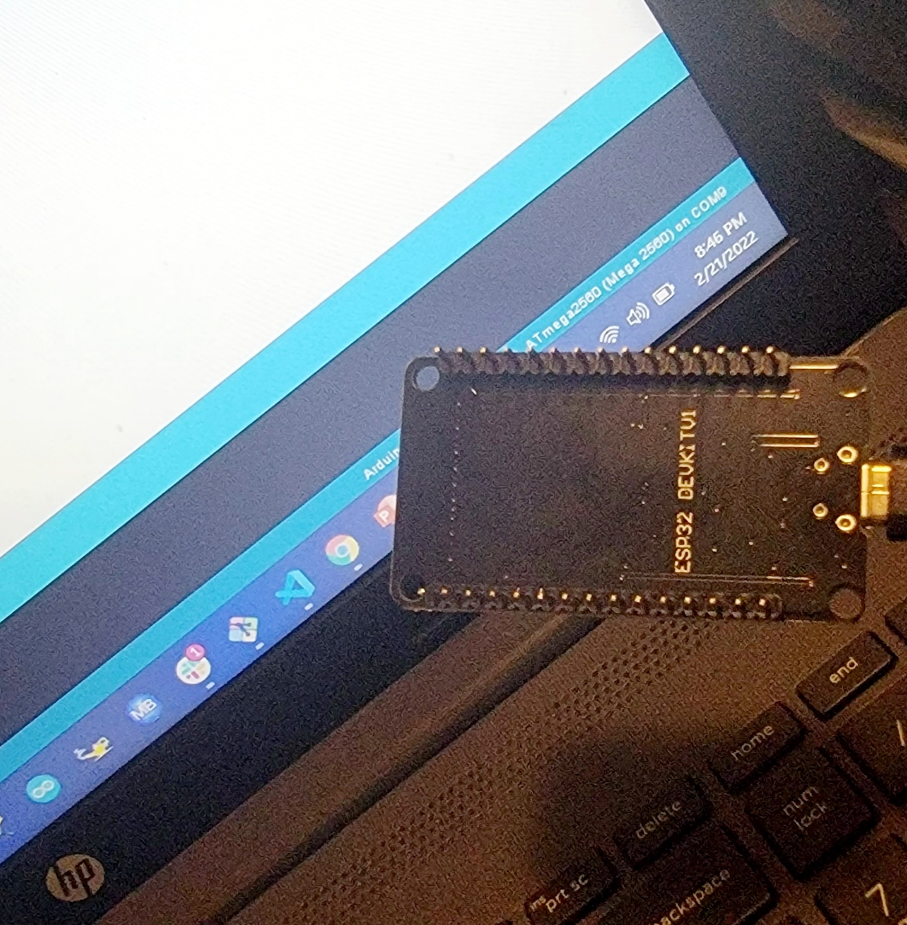
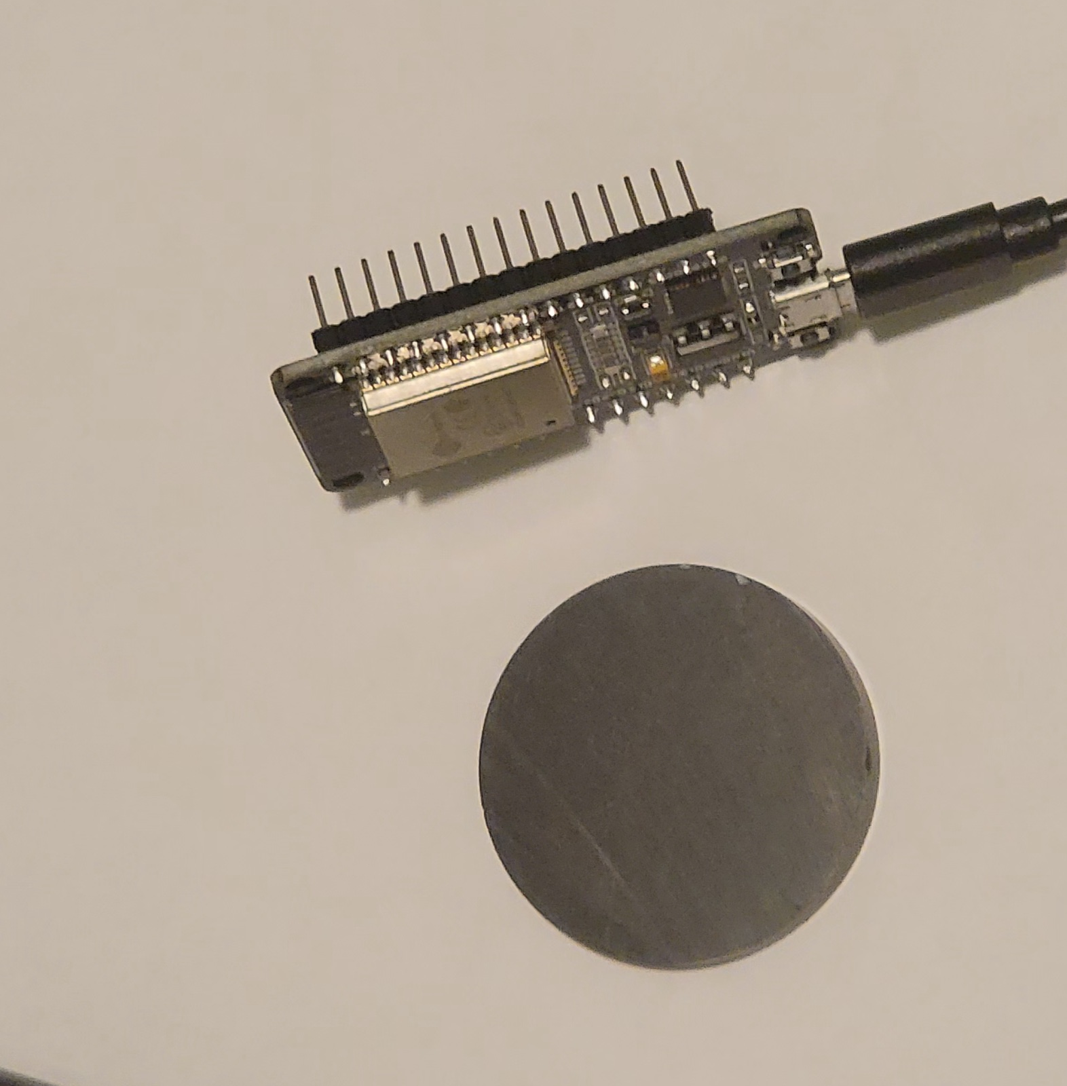
Experimental Set-up in different angle views (Picture)
Materials List:
ESP32 microprocessor
Micro-USB cable
Magnet

Slide 46
Raw Data (Screenshot)
Screenshot of Serial Monitor from Arduino IDE showing raw data.
Must include your name displayed in the Serial Monitor.
Press EN button to display name.
Unselect “Auto scroll” and scroll all the way up.

Slide 47
Data Analysis (Screenshot)
Screenshot data plotted in Excel.

Slide 48
Conclusions
Discuss the results and comment on the sources of error.
Answer: Distance of magnet and the ESP32 microprocessor.
The position of magnet on the processor.
Describe how the Hall sensor works. What are some applications for the Hall effect sensor?
Answer: Hall sensor works when there is change in magnetic field.
There are many applications that Current and voltage Measurements.
Magnetometer.
Car speed controllers.
https://www.magnelinkinc.com/blog/hall-effect-guide/
Motion sensors

Slide 49
Challenges and solution
Communication problem between Arduino IDE and computer,
If this problem occur, change different USB ports or update USB driver and connect again.
Misplacing cables in breadboard.
Make sure to match the controller plug labels and wires plug are in the same row on breadboard.
Dimensions of objects used in experiments.

Slide 50
Challenges…contd.
Not copying all the codes from Project guide that can alter the result (output).
Make sure to copy all the codes from provided project guide.
Time management
Attending Live sessions
Submitting assignments on scheduled time.
Personal time vs school schedule.

Slide 51
Career Skills Acquired.
Collecting data and analyzing then translating data in real life situations.
How to write scientific method and notation
Physical quantities and their explanation.
Laws of physics in our real life
Practical experience on Arduino IDE experience and Breadboard.

Slide 52
Conclusion
Physics is a branch of science that explains the universe using fundamental laws and mathematics.
Since IoT technology is part of our daily lives and physics describes the governing laws of the universe, various technologies can be utilized to demonstrate the governing laws of physics.
Having at basic of laws of physics helps in many aspects of career and in real life hacks.

