Slide 1
CEIS 101 course project smart home automation and security system
By; Temesgen Kune Oct,2020
Notes:
NOTE:
To change the image on this slide, select the picture and delete it. Then click the Pictures icon in the placeholder to insert your own image.

Slide 2
Introduction
Develop a smart home automation and security system by designing the prototype in Tinker cad, building the hardware with the components from the IoT Tech Core Kit and programming within Arduino IDE.
Optional components can be added to the smart home system including a water level sensor to monitor for possible flooding as well as a temperature and humidity sensor to monitor the weather conditions.

Slide 3
Circuit Simulation in Tinkercad
.

Slide 4
Circuit (screenshot)

Slide 5
Code (screenshot)

Slide 6
k
Inventory of Parts, Circuit Building, and Displaying Messages

Slide 7
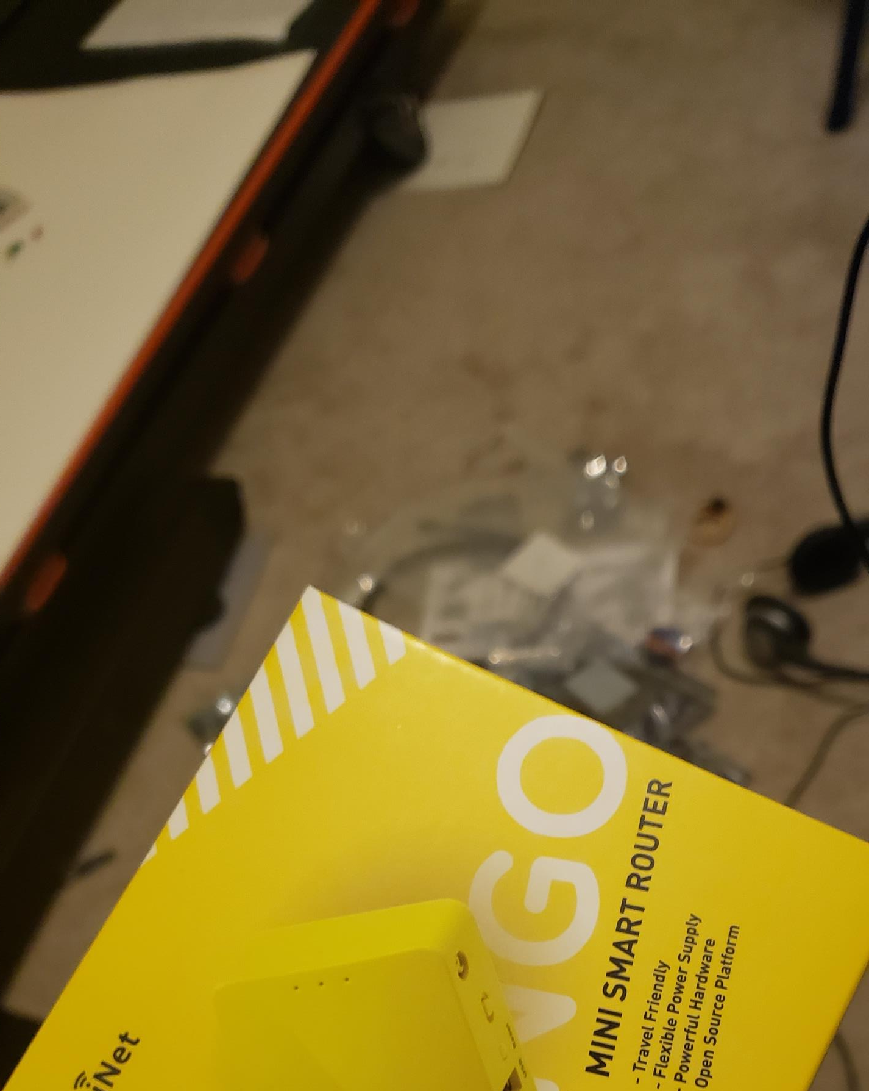
Inventory of IoT Kit (picture)
UCTRONICS Kit
ESP32 (2)
LCD Modules (2)
Breadboards (3)
Mini Router
Patch Cable
Digital Multi Meter
USB to Micro USB (2)

Slide 8
Organization of Project Components (picture)
Arduino Mega 2560
Breadboard
Resistor 10kΩ
LEDs
Ultrasonic Sensor
Passive Buzzer
Photoresistor
Wires
USB Type B cable

Slide 9
Circuit with red LED on (picture)

Slide 10
Serial Monitor (screenshot)

Slide 11
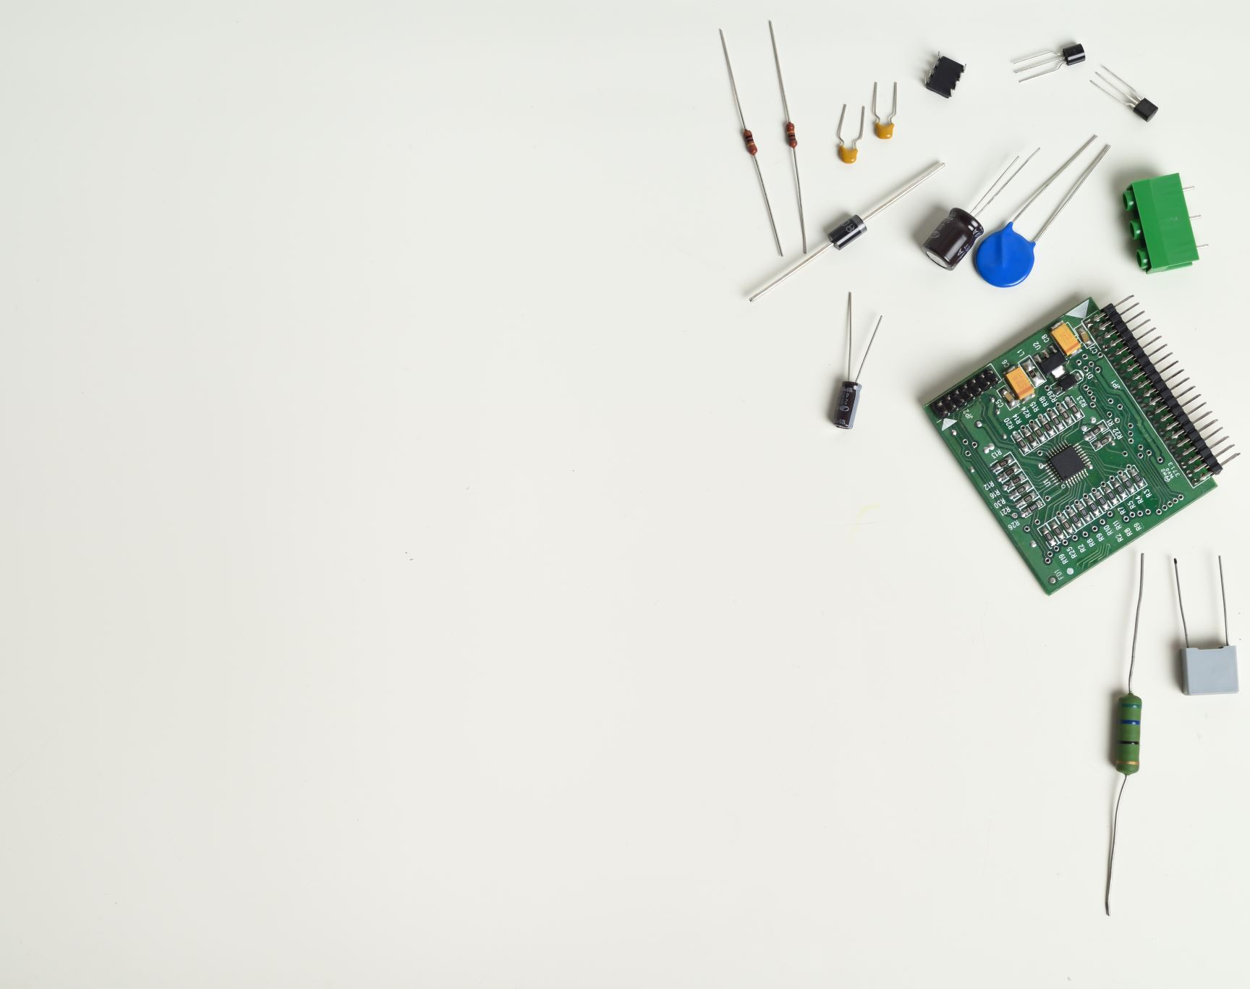
Adding Door Sensor to Smart Home System
.

Slide 12
Circuit of door closed with Green LED ON (picture)

Slide 13
Circuit of door open with Green LED OFF (picture)

Slide 14
Arduino Code (screenshot)

Slide 15
Serial Monitor (screenshot)

Slide 16
.
Adding Distance Sensor to Smart Home System and Conducting Data Analysis

Slide 17
Circuit with green LED on

Slide 18
Circuit with yellow LED on

Slide 19
Circuit with red LED on

Slide 20
Below is the video with sound and all three lights displayed in Arduino.
Play the video here

Slide 21
Arduino Code

Slide 22
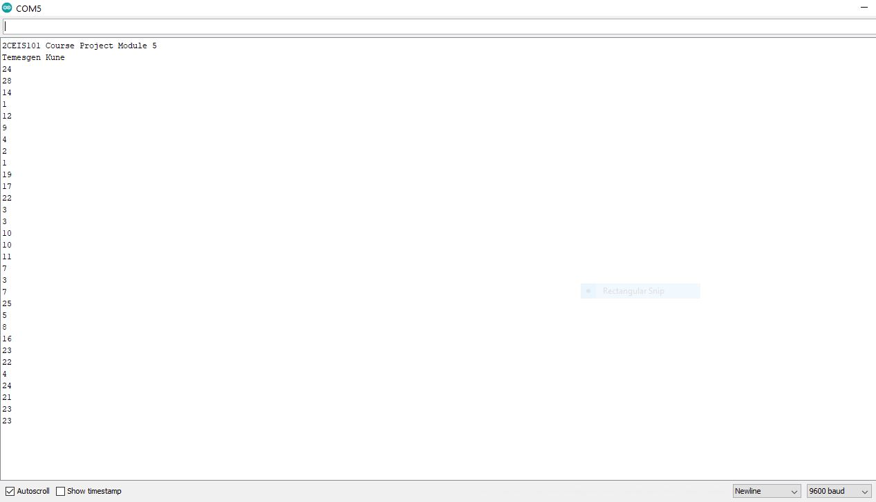
Serial Monitor

Slide 23
Plot of data (graph from Excel)

Slide 24
.
Adding Automated Light to Smart Home System

Slide 25
Circuit with automated LED off

Slide 26
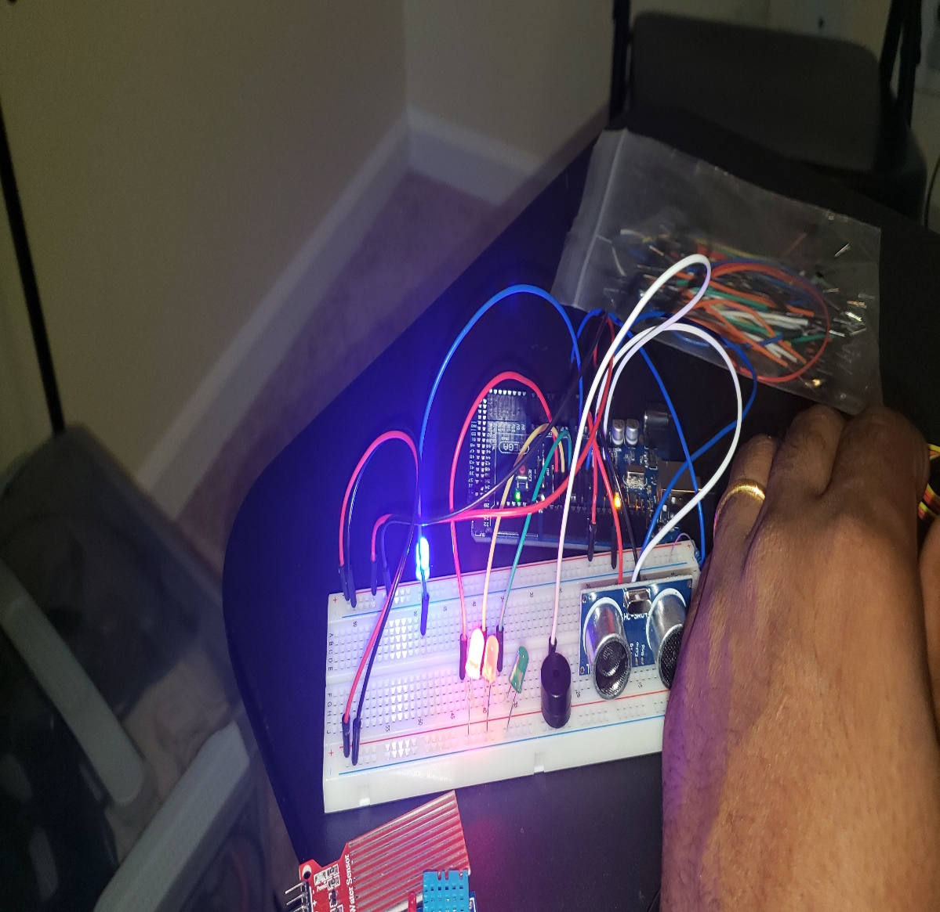
Circuit with automated LED on (picture)

Slide 27
Arduino Code (screenshot)

Slide 28
Serial Plotter (screenshot)

Slide 29
Challenges
USB cable not recognized by laptop to power-up the Arduino.
Change different USB port.
Restart Arduino.
The serial code not uploading and error results.
Double check the source where it copied.
Missing placing cables in breadboard powered line.
Check the right pin in breadboard.
The LED’s not showing the output after code upload.
Change the LED.
Missing the moment of LED light output to take picture.
Increasing delay time for the time.

Slide 30
Career Skills Acquired
Hardware and Software Knowledge
How Arduino and Arduino code works.
Breadboard and Cables.
Input and output devices.
Sensors in IOT devices.

Slide 31
Conclusion
This project Introduced me good understanding of IOT devices as well as how internet of things works in the real world.
The Arduino Kit that has a lots of hardware materials like Resistors, Photo receptors, LED and a lot more; that taught me a lot on hardware knowledge.
The project is hands on training for beginner programmers and introduces programing languages .

