Slide 1
DeVry University
Final course project for
Fundamentals of Infrastructure Security (SEC290)
April 2022, By: Temesgen Kune

Slide 2
Introduction
New technologies and applications are being developed on a regular basis.
It is important to stay current with the skills required for evolving
job market and to take advantage of the many available learning opportunities.
This project covers fundamentals of infrastructure security.
Configuring firewall rules,
Deploying Snort sensors for network intrusion detection,
Exploring SSL encryption,
Analyzing traffic to detect attacks,
Exploiting Microsoft vulnerabilities, and
conducting live memory analysis.

Slide 3
Course Project
Fundamentals of Infrastructure Security (SEC290)
Module 1
Manual Vulnerability Analysis (on a test VM network)
Temesgen Kune

Slide 4
Microsoft Windows Bulletin MS08-067 vulnerability
Take a screenshot of the output in Part 2, Step 2.
It should show that a vulnerability exists on the test VM.

Slide 5
Microsoft Windows Bulletin MS17-010 vulnerability
Take a screenshot of the output of the nmap command in Part 3.
It should show that a vulnerability exists on the test VM.

Slide 6
Meter preter session command output
Take a screenshot of the output of the meter preter session commands in Part 4, Step 13 or Step 14.

Slide 7
Additional Slides

Slide 8
Additional Slides

Slide 9
Module 2
Manual Vulnerability Analysis (on a test VM network)

Slide 10
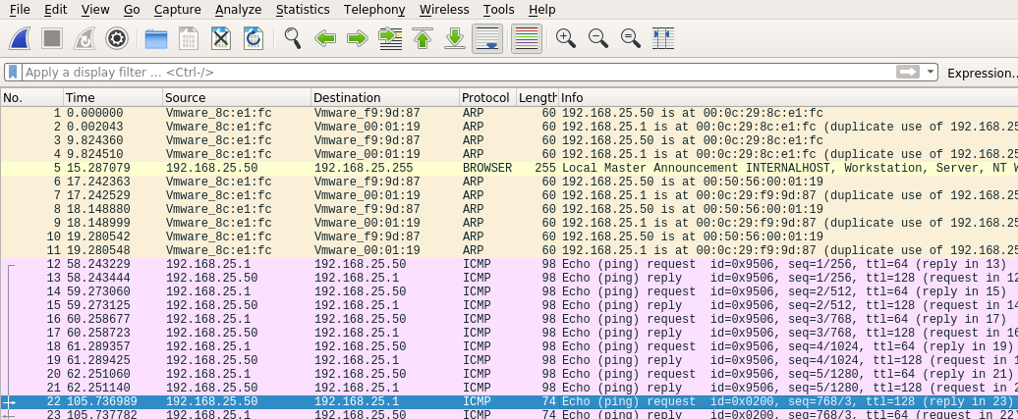
Basic attack analysis
Take a few minutes to review the packet trace and attempt to analyze what is taking place.
Answer here:
Look at packet no. 20 and packet no. 22. They are both ICMP traffic, but what are the differences between the packets? Different source and destination.
Why do you see the differences do you think? Different operating systems (Different VMwares

Slide 11
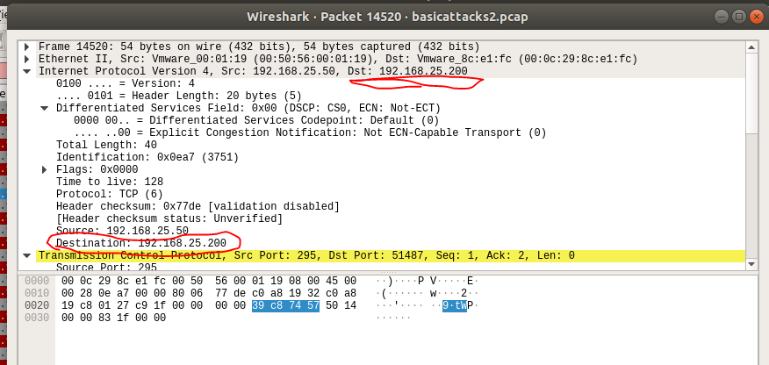
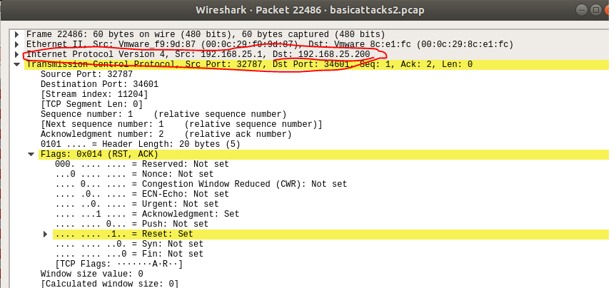
Web attack and advanced analysis
Review packet no. 37 and beyond, what do you think is taking place here? Three-way handshake because it is TCP.
Look at packet no. 14520 and 22486 and compare the packets, is there anything suspicious about these packets? Reset flag.
Are there different destinations being targeted? No. The same destinations 192.168.25.200

Slide 12
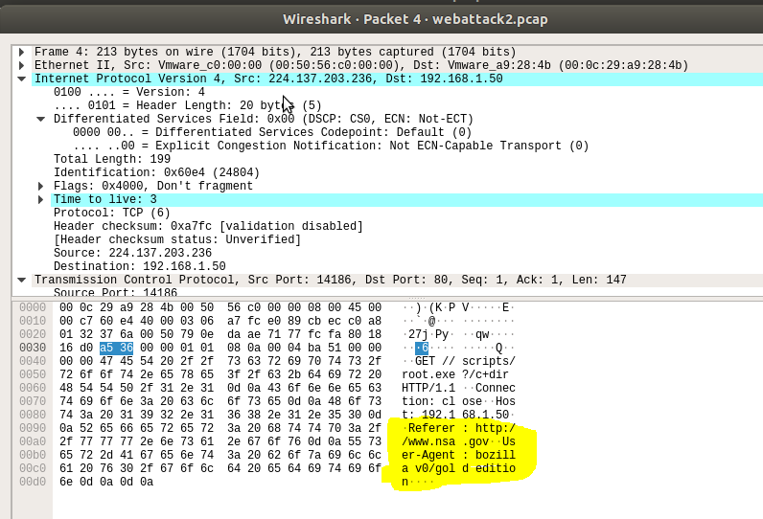
Web attack and advanced analysis cont’d
We have uncovered quite a bit of information in this trace, but have we identified anything of compromise thus far?
Answer here:
What web attack(s) is/are identified as successful within the trace? HTTP and TCP
Locate packet no. 4, do you see anything of interest in the packet session? NASA

Slide 13
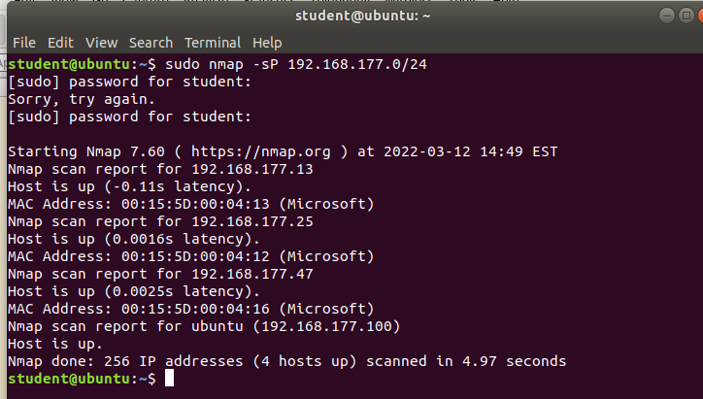
Additional Screen Shots

Slide 14
Module 4
Snort
Temesgen Kune

Slide 15
Rubric
Activity | Requirement(s) | Points
Testing Snort rules | Take two screenshots | 30
Creating Snort rules | Take two screenshots | 30

Slide 16
Testing Snort rules
Take a screenshot of the output in Part 1 Step 8.
It should show the transcript of the XMAS scan alert.

Slide 17
Testing Snort rules cont’d
Take a screenshot of the output in Part 1 Step 10.
It should show the TCP packets generated by the XMAS scan.

Slide 18
Creating Snort rules
Take a screenshot of the output in Part 2 Step 5.
It should show the ping activity alert.

Slide 19
Creating Snort rules cont’d
Take a screenshot of the output in Part 2 Step 6.
It should show the ICMP packets generated by the ping activity.

Slide 20
Module 5
Live Memory Analysis
Temesgen Kune

Slide 21
Linux Processes
Take a screenshot of the output in Part 1 Step 9.
It should show port 55000 open for both IPv4 and IPv6.

Slide 22
Process Hacker
Take a screenshot of the output in Part 2.
It should show properties of a chosen process.

Slide 23
Process Monitor
Take a screenshot of the output in Part 3 Step 7.
It should show ifFaceName in the Path column and Data: Roman in the Detail column.

Slide 24
Volatility
Take a screenshot of the output in Part 4 Step 8.
It should show compromised network connections.

Slide 25
Additional slides
.

Slide 26
Additional slides
.

Slide 27
Module 6 Fundamentals of Infrastructure Security

Slide 28
Time-based access
Take a screenshot of the output in Part 1 Step 28.
It should show two time-based access rules in the FORWARD chain.

Slide 29
Dynamic NAT
Take a screenshot of the output in Part 5 Step 3.
It should include prerouting and postrouting rules.

Slide 30
Brute forcing of SSH logins
Take a screenshot of the output in Part 6 Step 7.
It should show the dropped SSH packet count.

Slide 31
Additional Slide

Slide 32
Challenges
Virtual machine connection congestion.
Typing errors while in VM terminals.
Unexpected outputs from the commands.
Data inconsistency.

Slide 33
Career skills obtained
Working on Virtual Machine.
Data analysis.
Troubleshooting errors in coding.
Process tracking

Slide 34
Conclusion
Conclusion
As a beginner, it is an amazing experience working on virtual environment.
Applications and process tracking experiences are helpful in future career.
The project is hands on training for beginner network security.
Experience of Analyzing data

